Slide 1
THREE BASIC RULES TO SOLVE ANY PATTERN TYPE QUESTION
Count the Number of Rows
Count the Number of Columns for each row.
Find the Relationship between Row and the Column

Slide 2
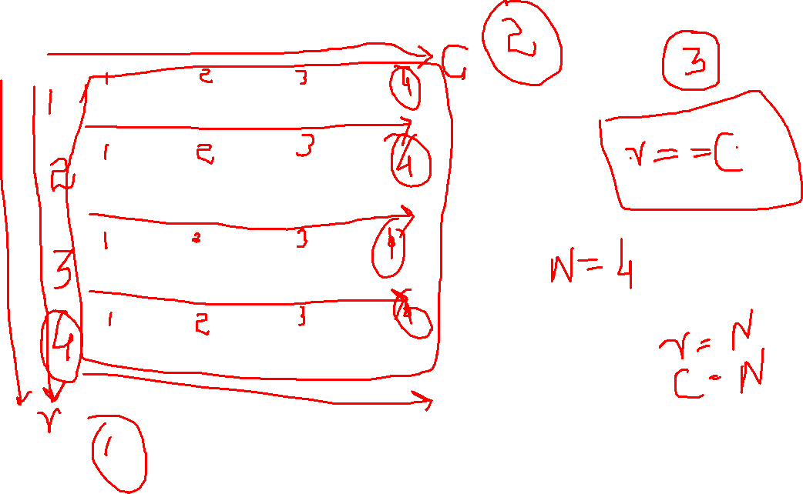

Slide 3
C
for(){ row
for(){ column }
}
R

Slide 4
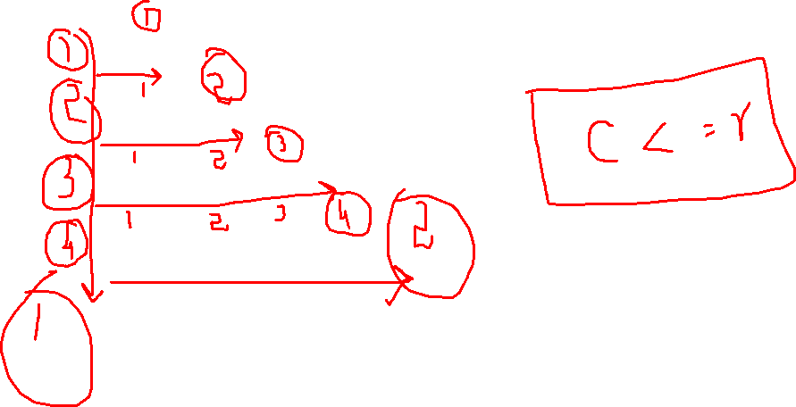

Slide 5
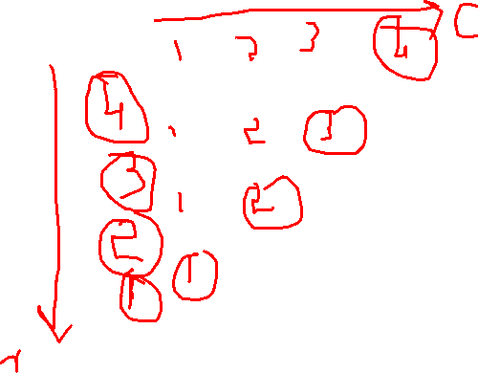
For Inverting Any shape Just Inverse the outer for loop

Slide 6
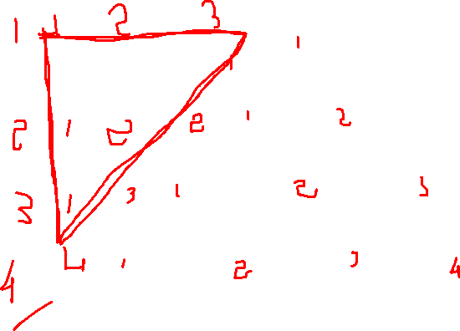
Note:
Here is the fourth rule of Patterns.. For the above type patterns we also need to count the Spaces and find the underlying pattern.. And find a relationship to embed both the patterns (Space pattern and start pattern) into a single loop

Slide 7
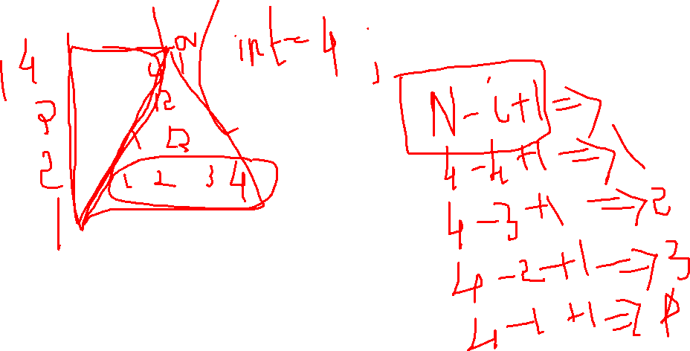

Slide 8
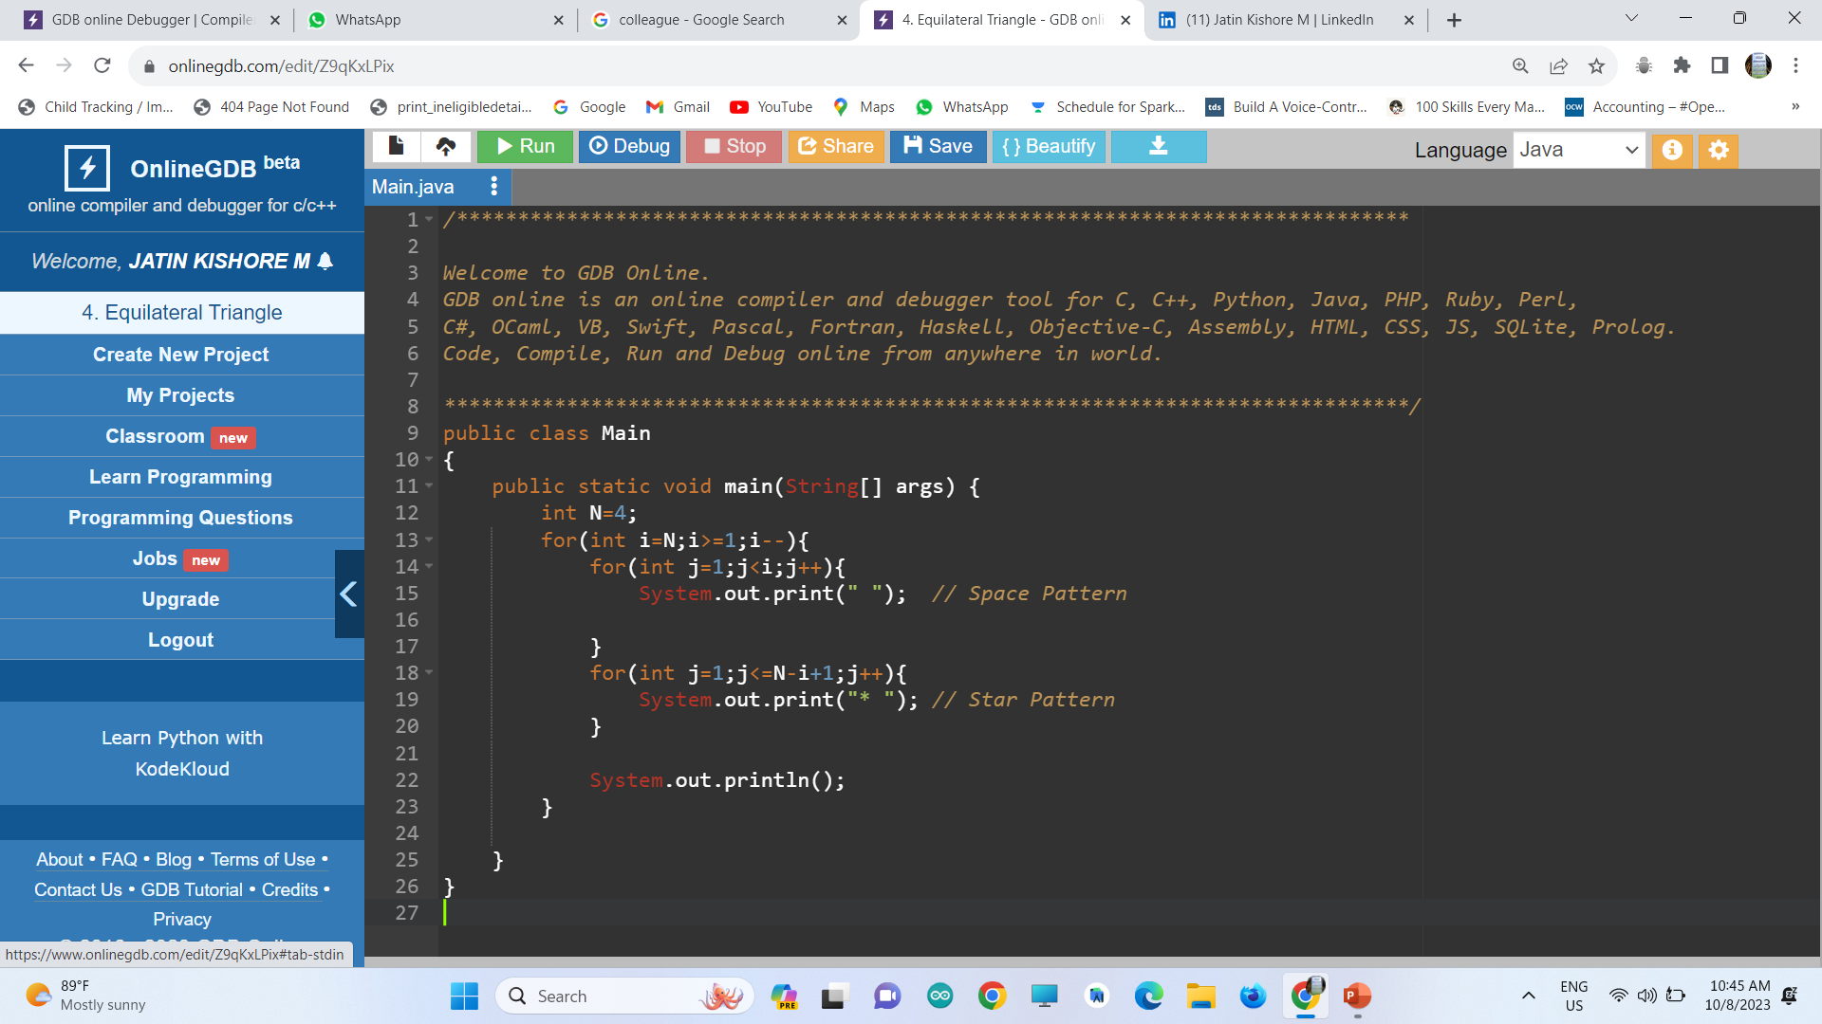
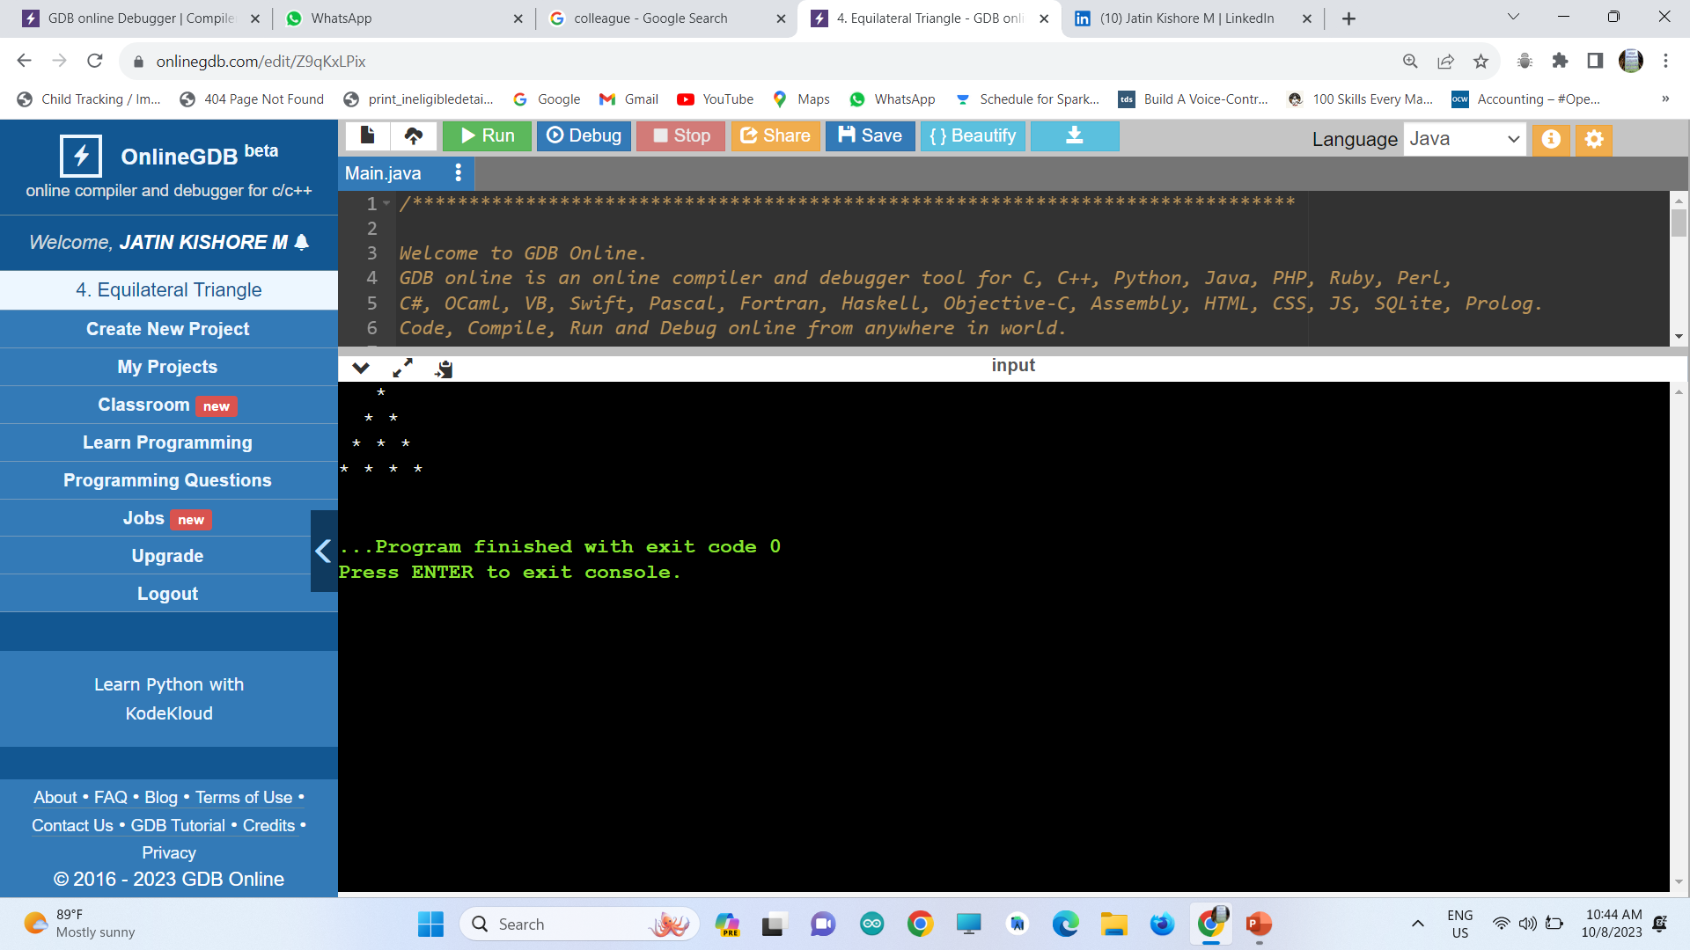

Slide 9


Slide 10
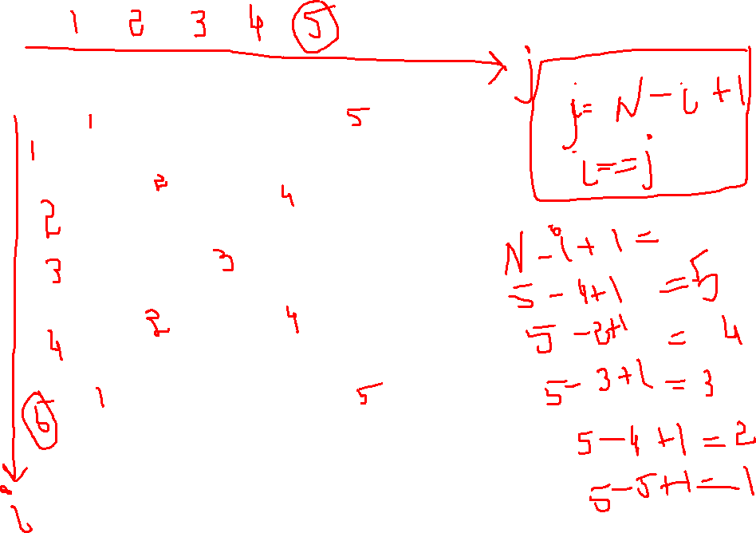


Slide 11
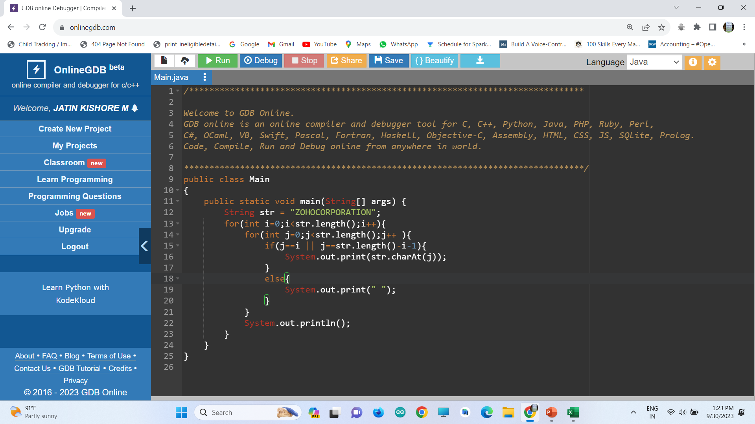
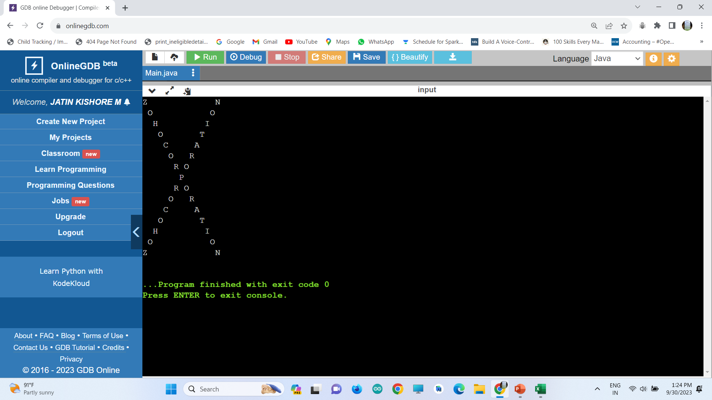
Initialize i =0 & j =0
Formula change : str.length() –i -1

Slide 12
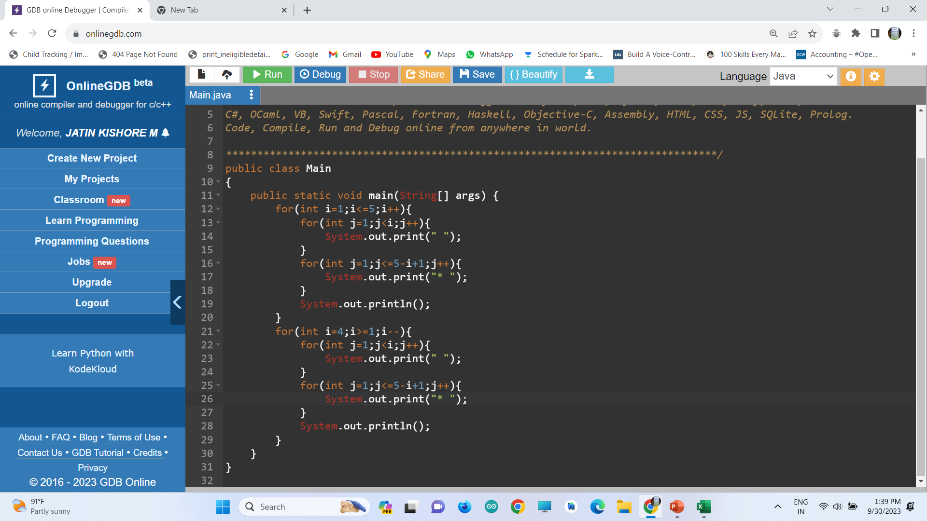
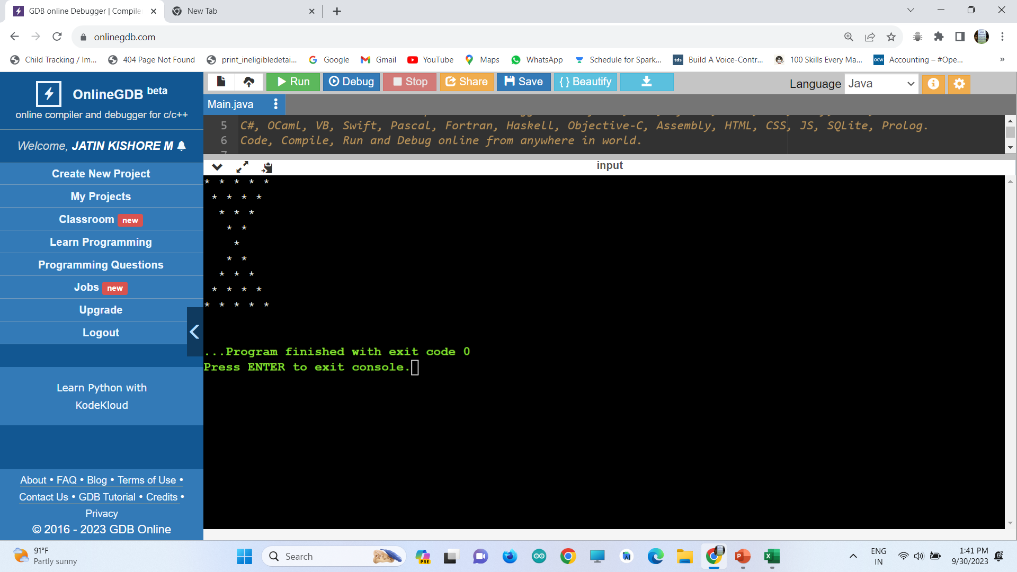
HOUR GLASS

Slide 13
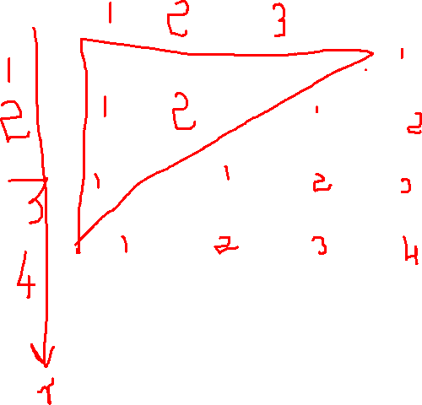
LEFT ALIGNED RIGHT ANGLE TRIANGLE

Slide 15
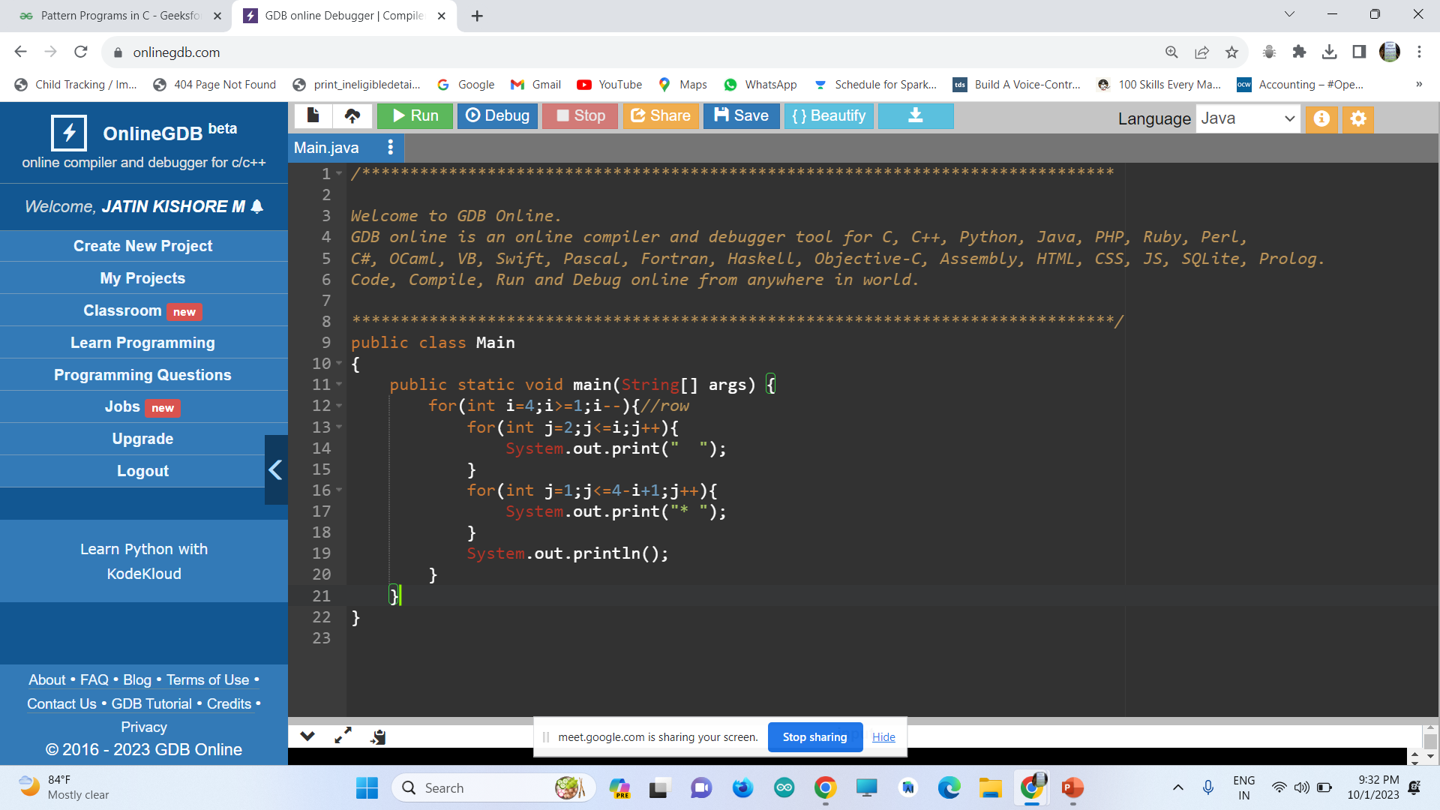
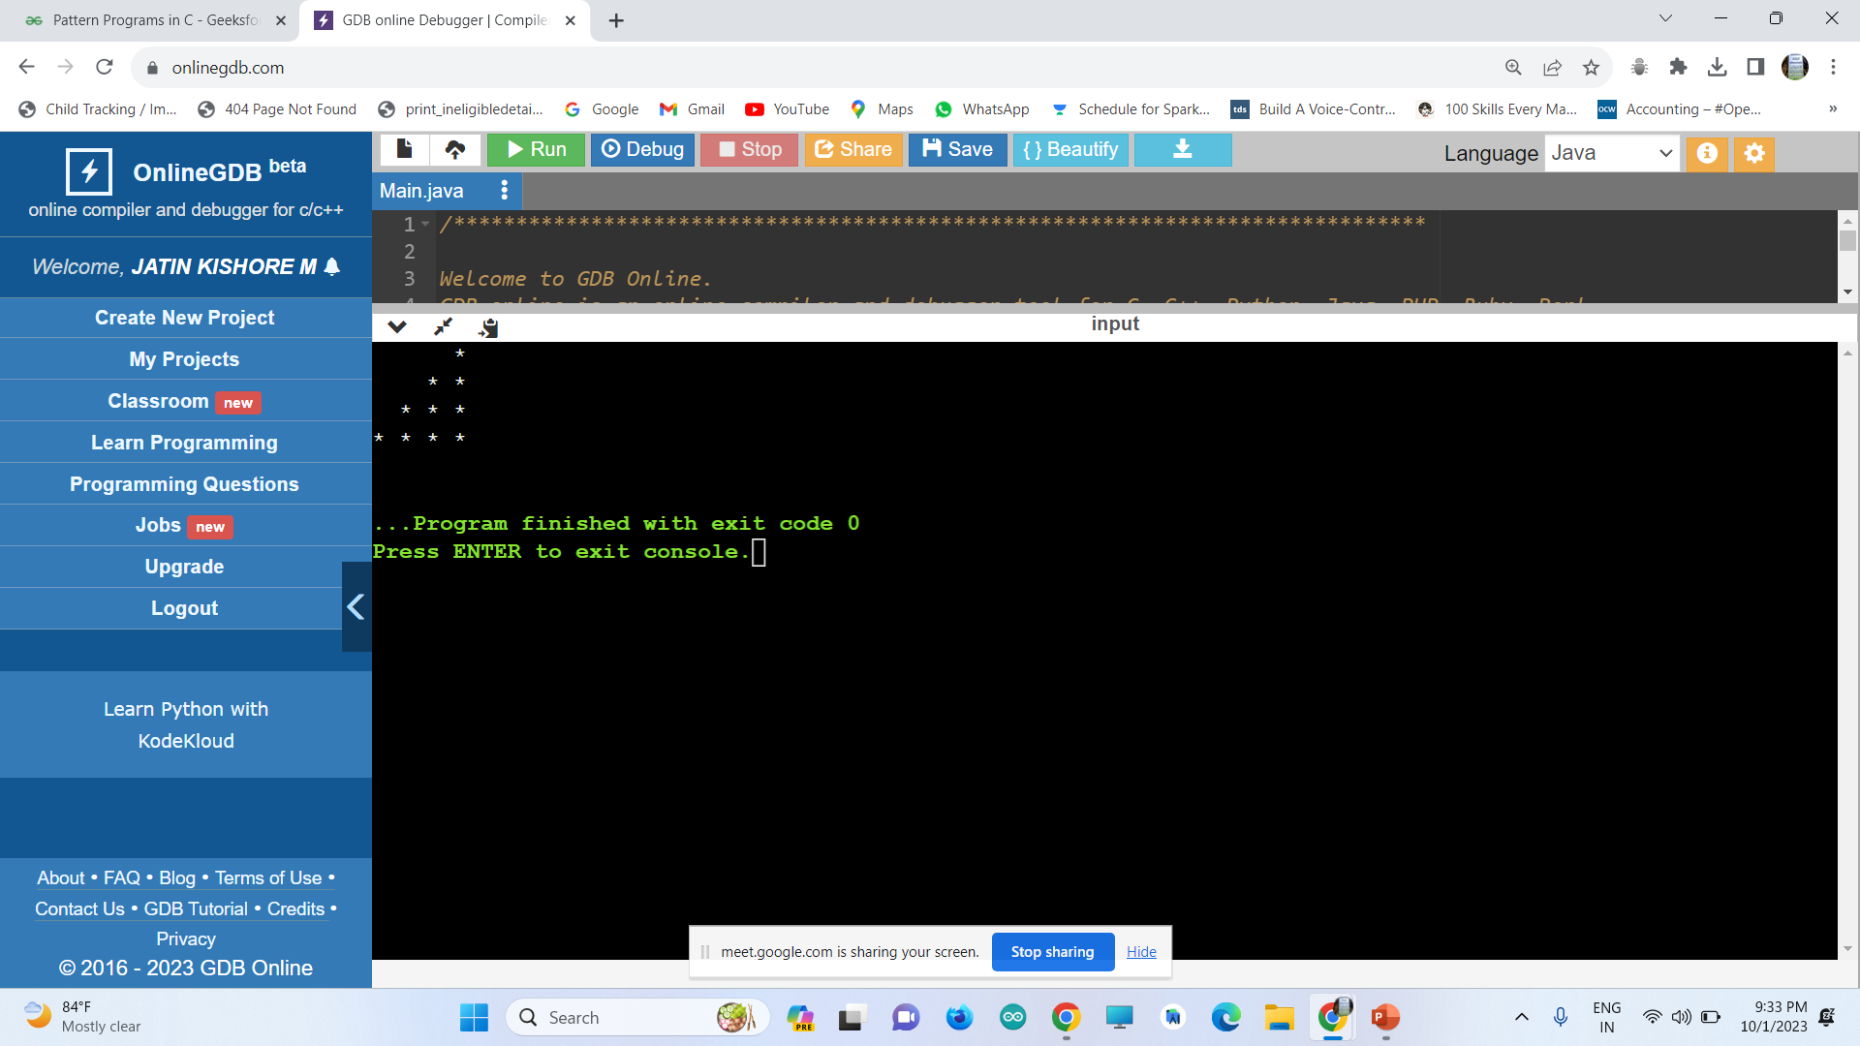

Slide 16
INVERTED RIGHT ANGLE LEFT ALIGNED TRIANGLE

Slide 17
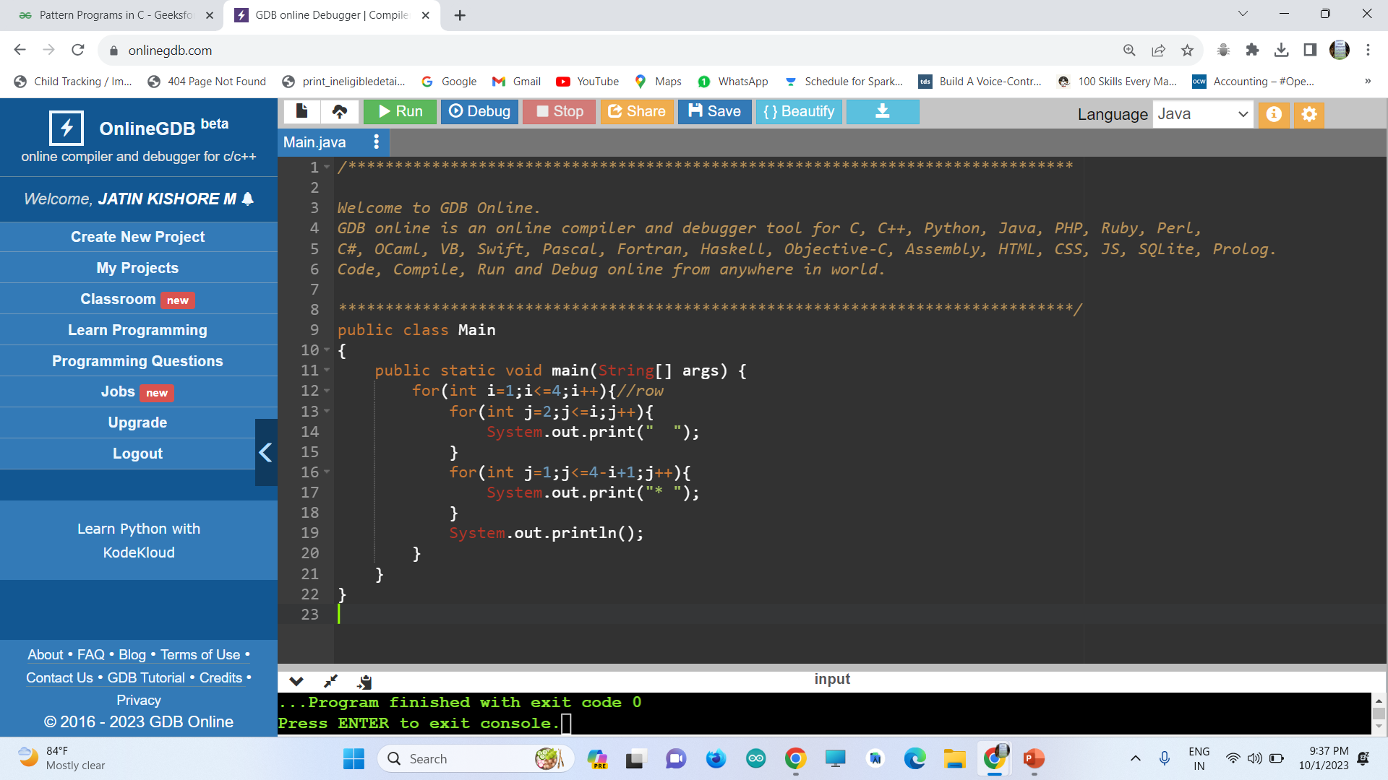
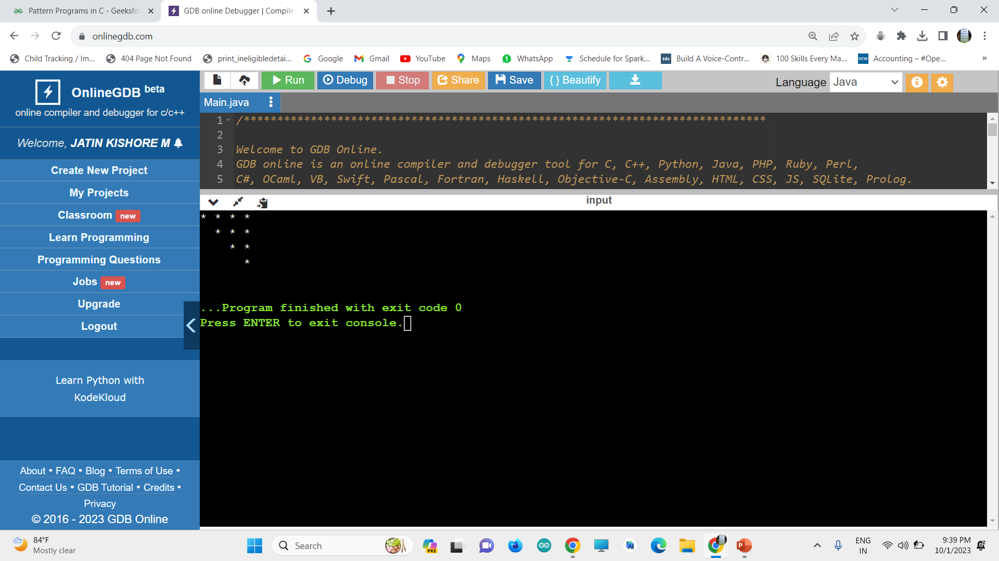

Slide 18
INVERTED FULL TRIANGLE

Slide 20
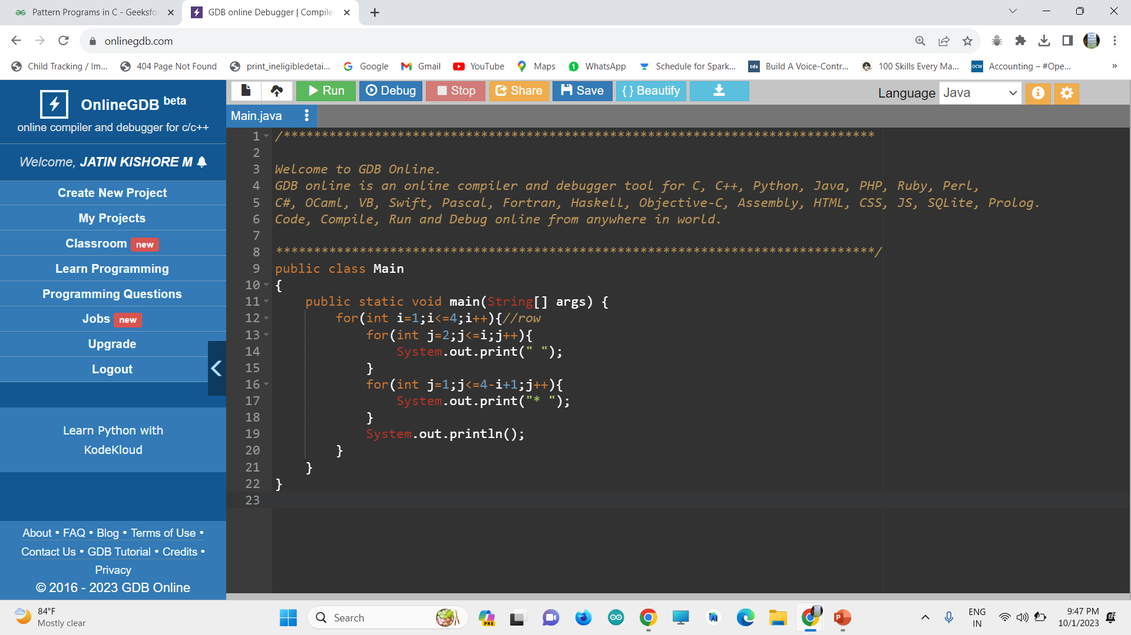
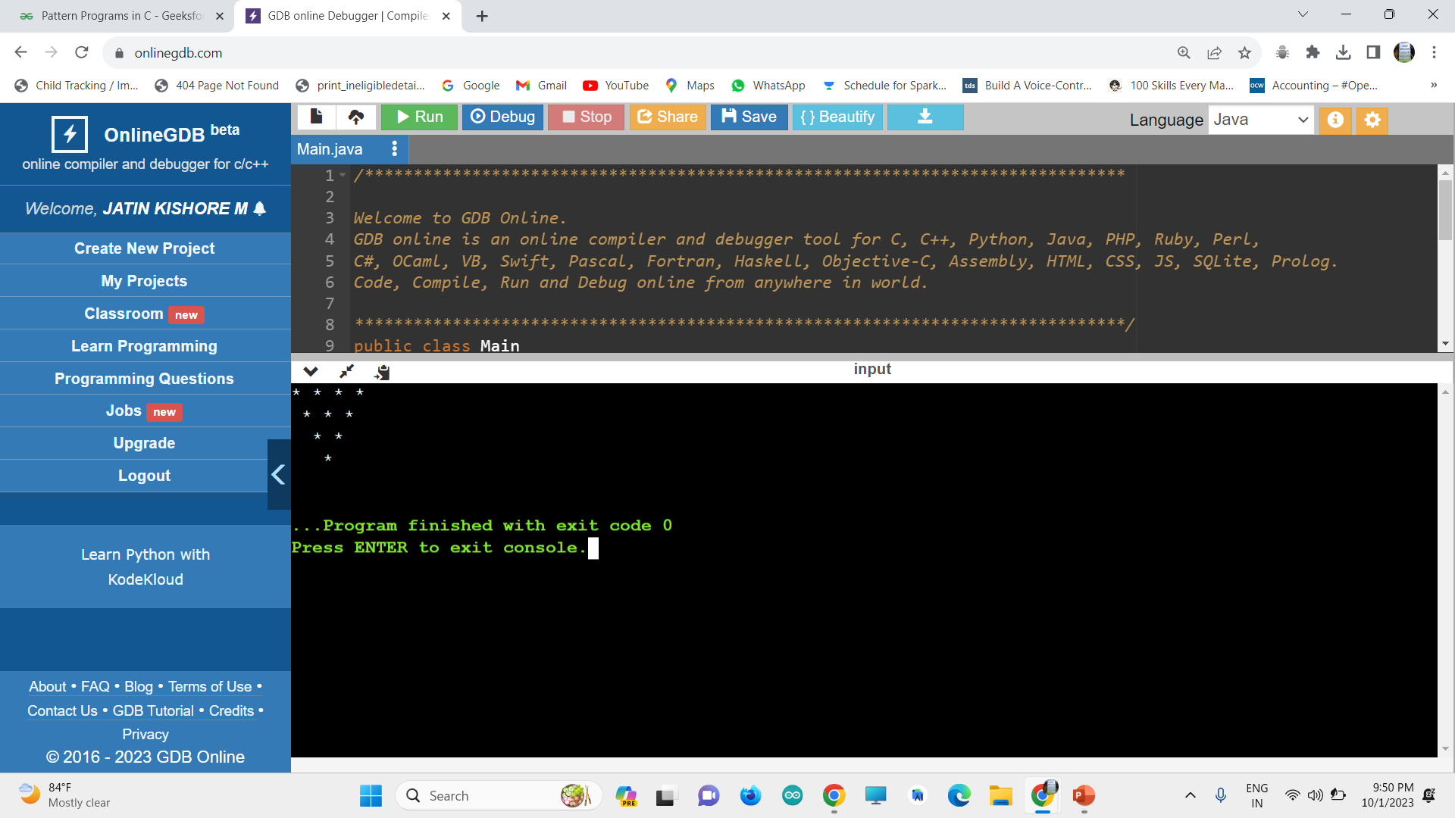

Slide 21
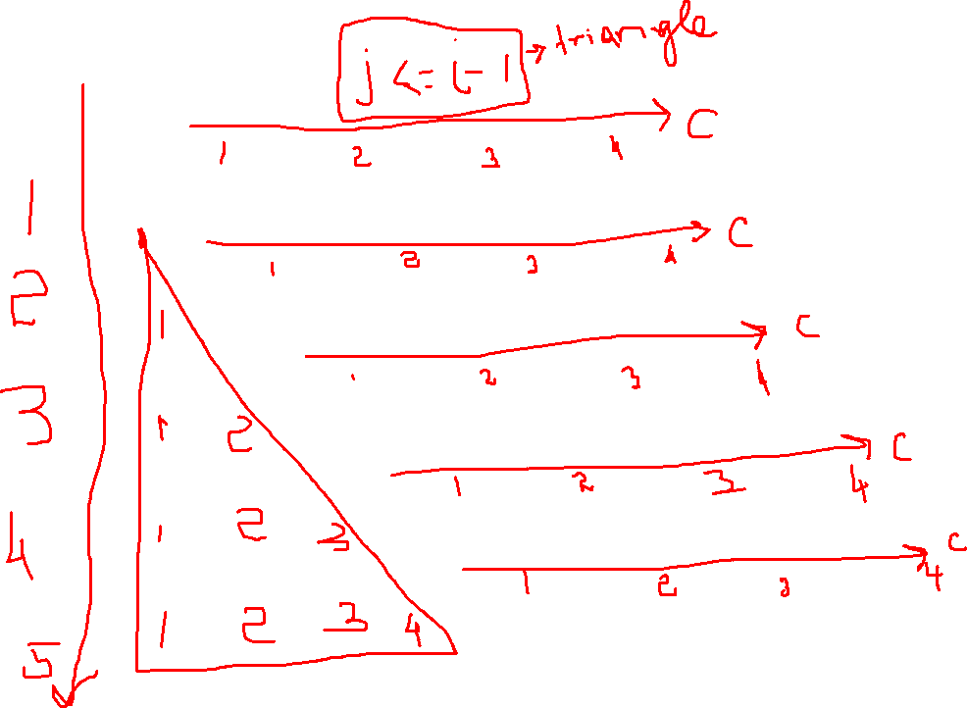
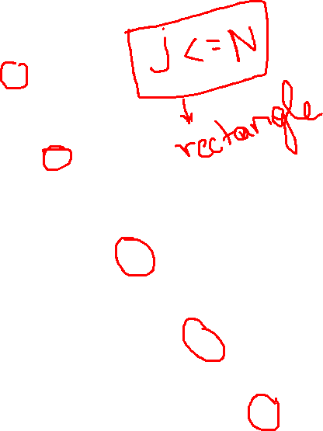
RHOMBUS

Slide 22
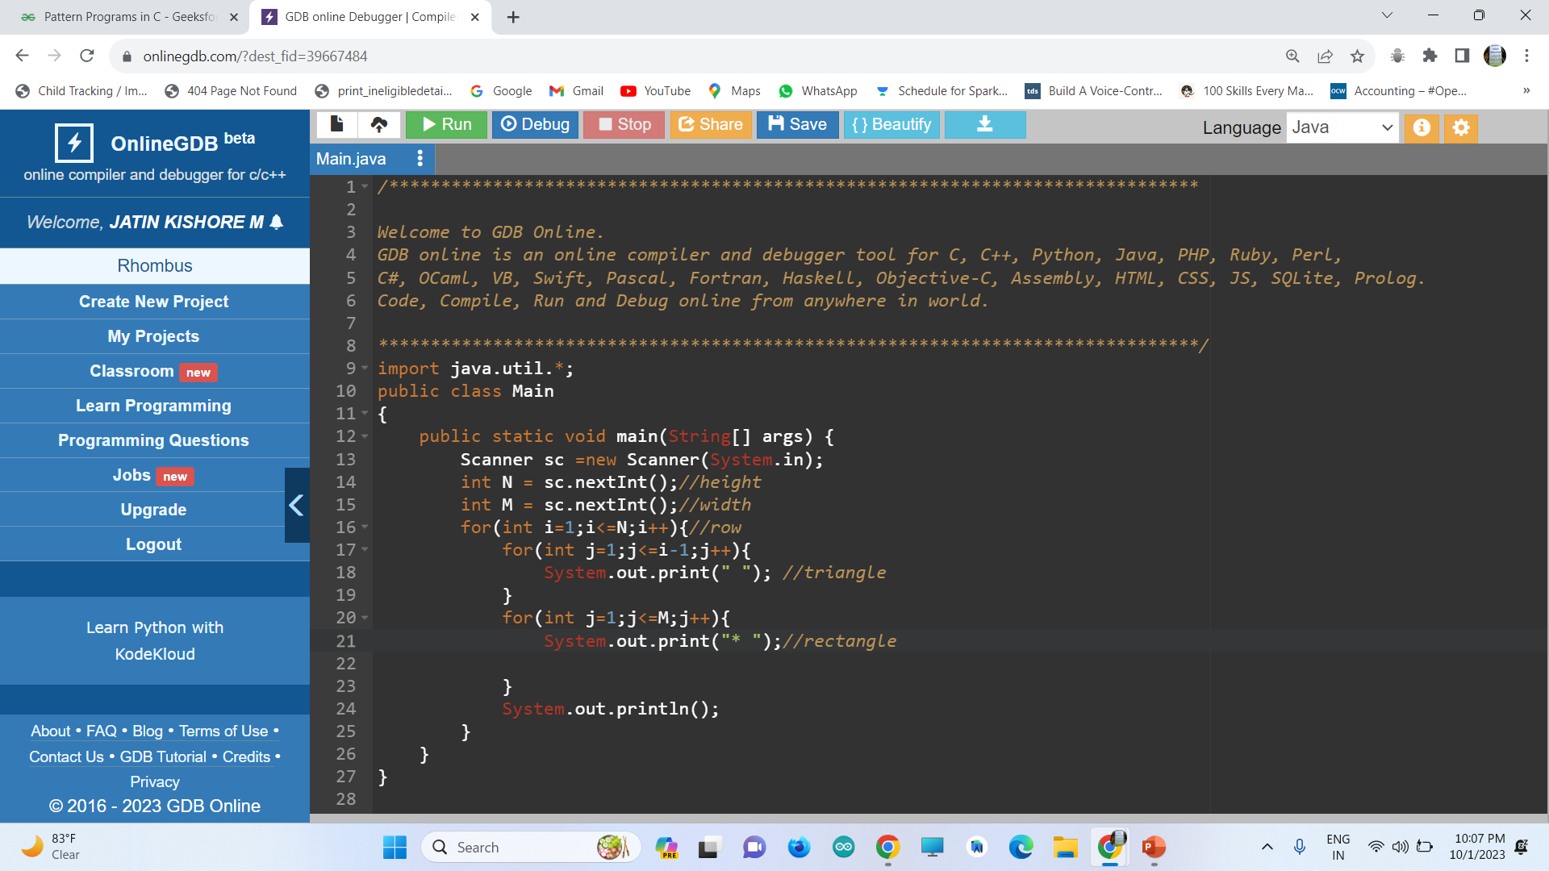
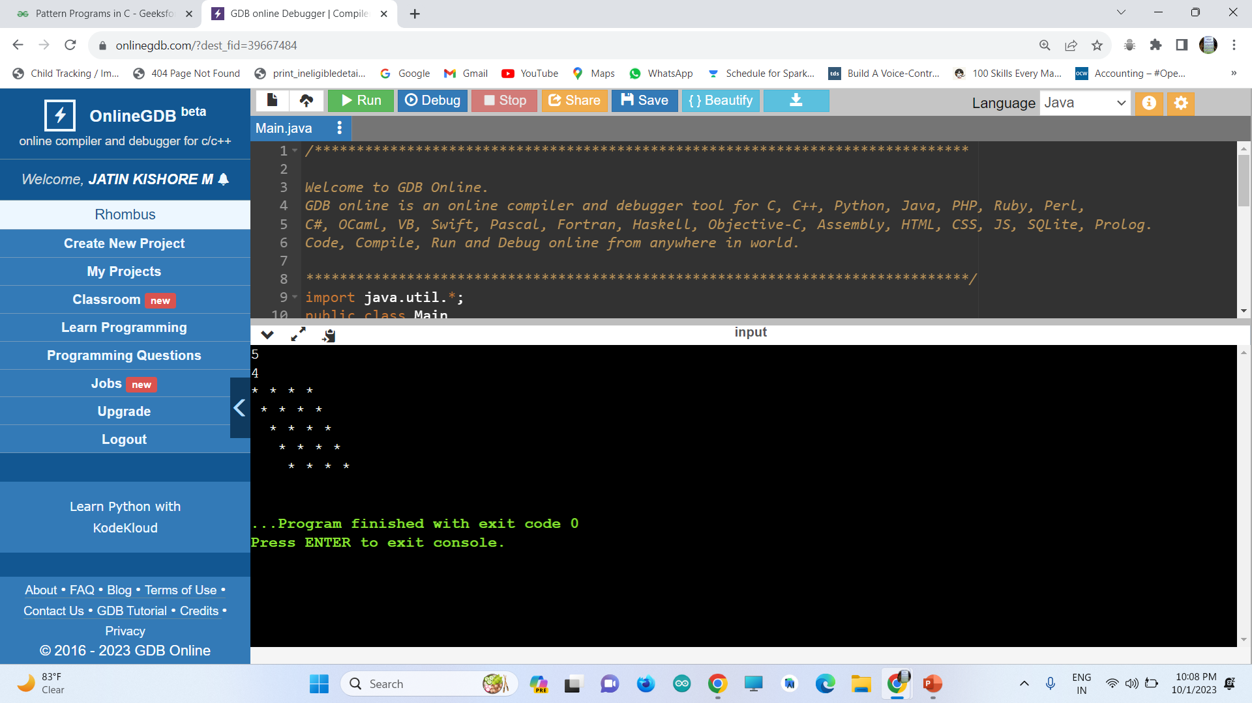

Slide 23
HOLLOW SQUARE

Slide 24
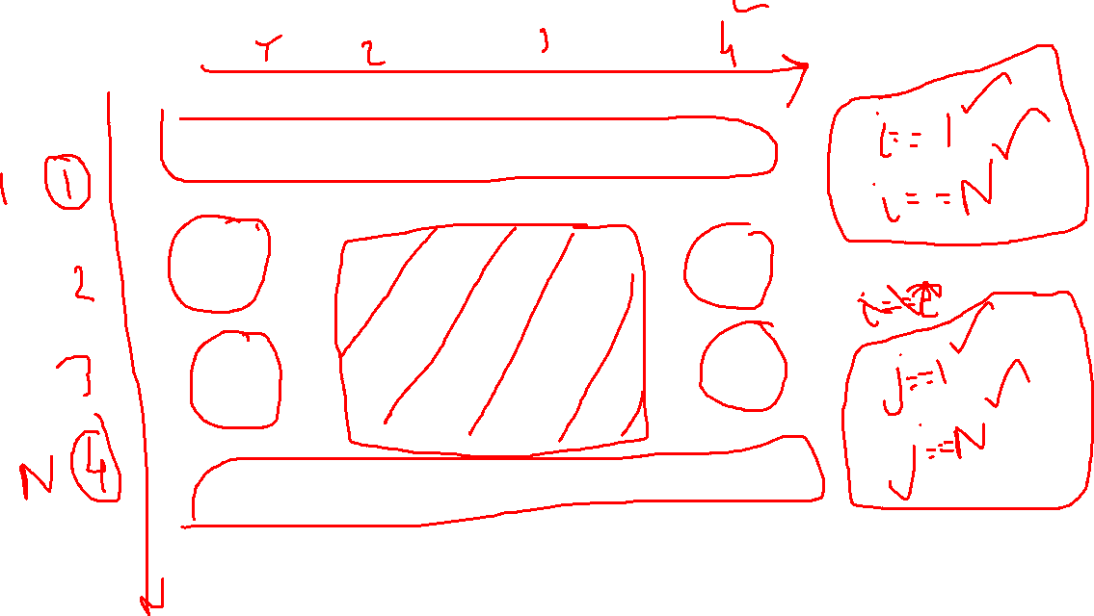

Slide 25
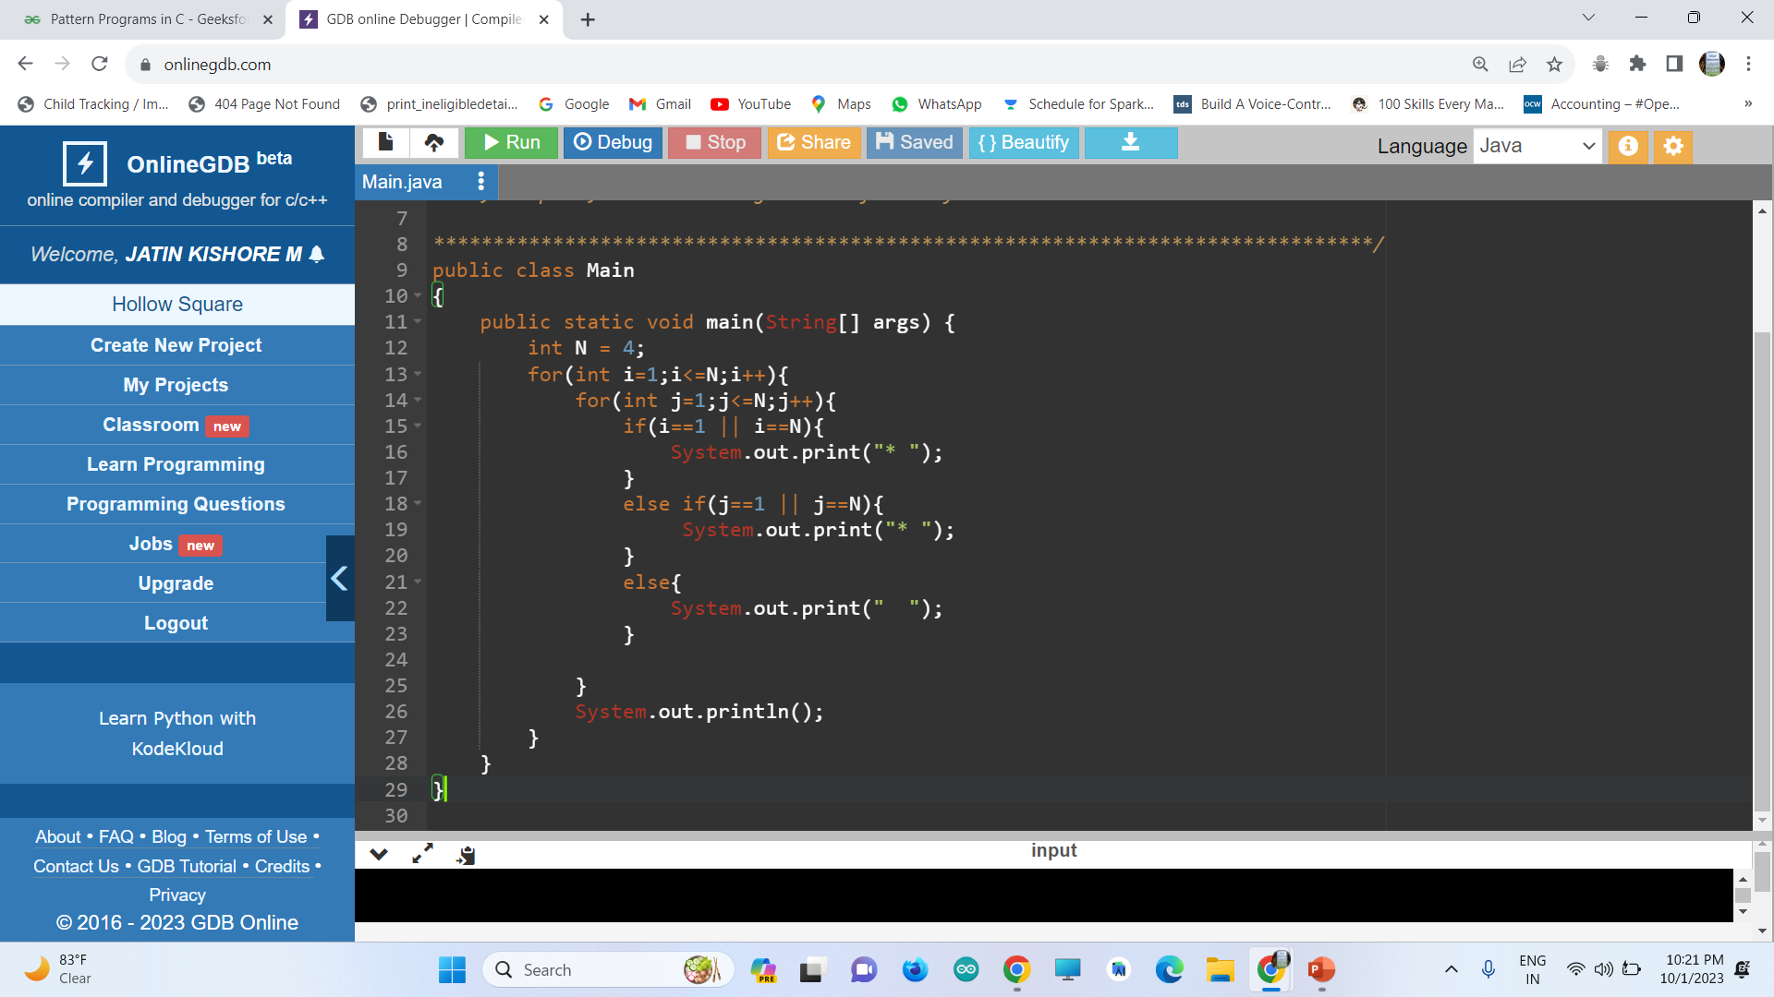
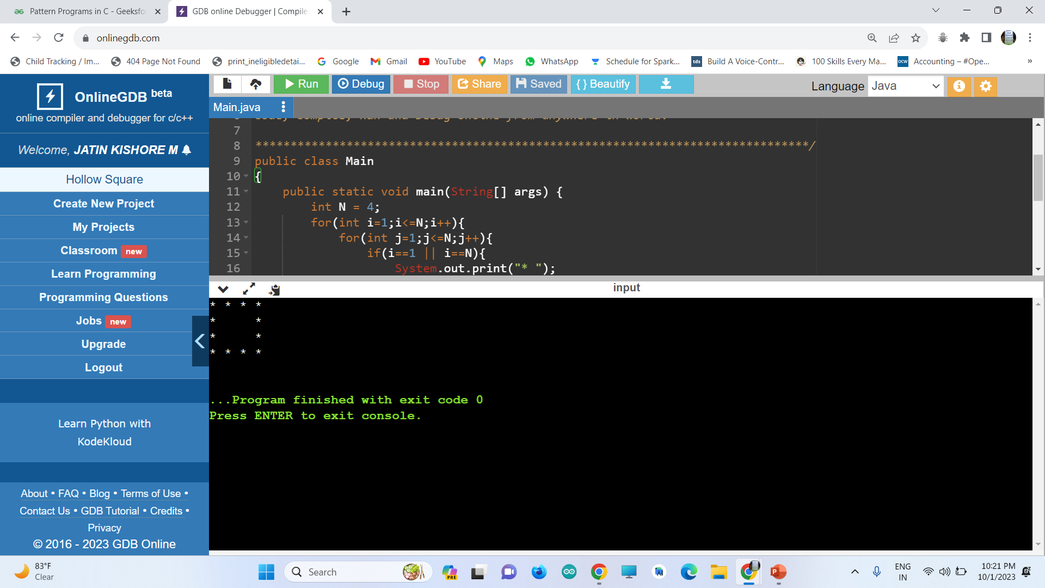

Slide 26
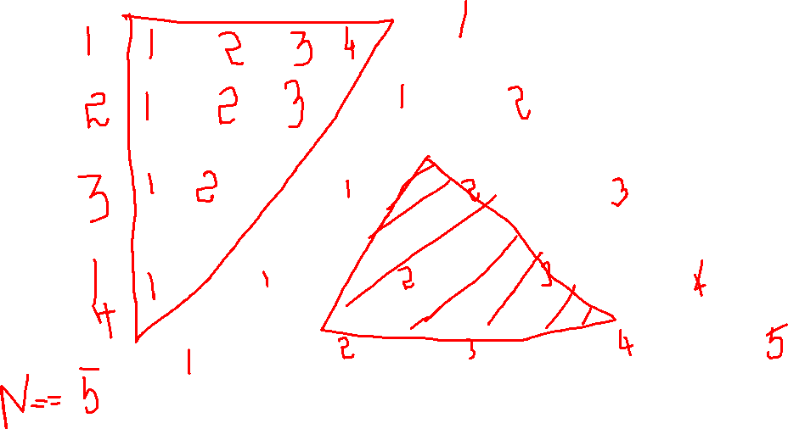
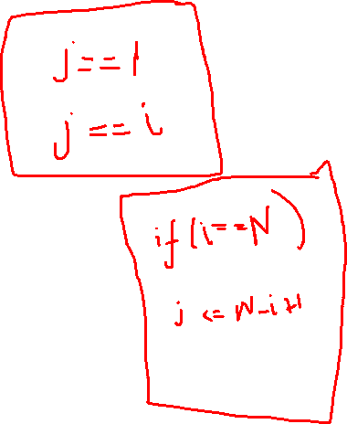
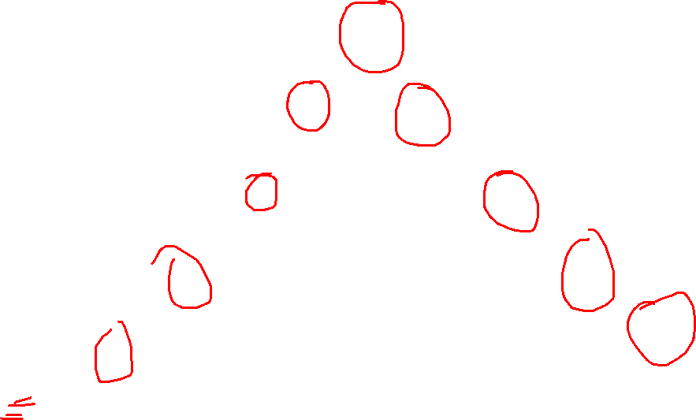
HOLLOW TRIANGLE

Slide 27
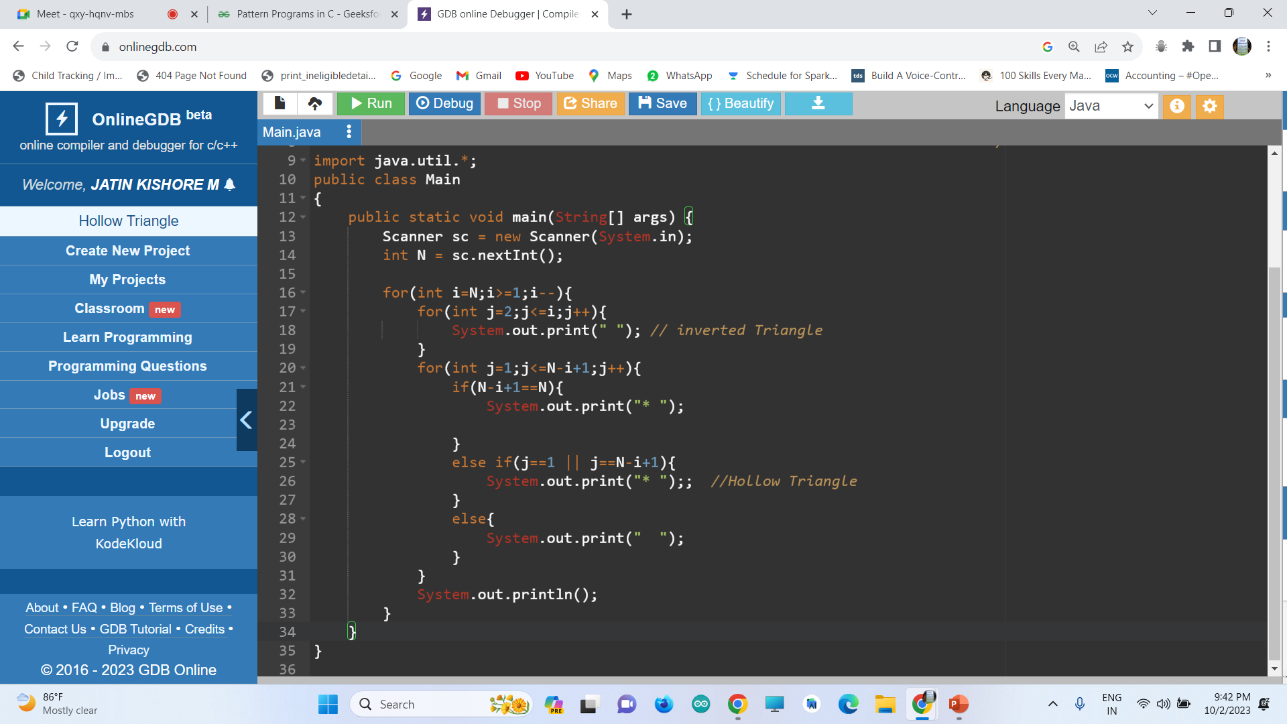
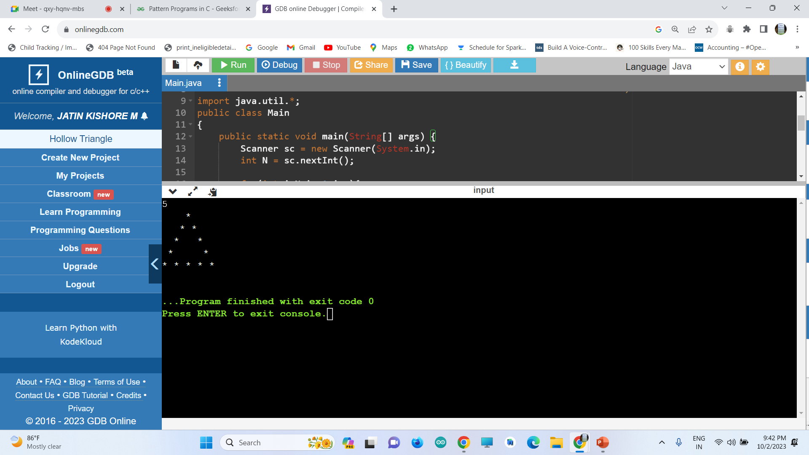

Slide 28
INVERTED HOLLOW TRIANGLE
Reverse the i loop

Slide 29
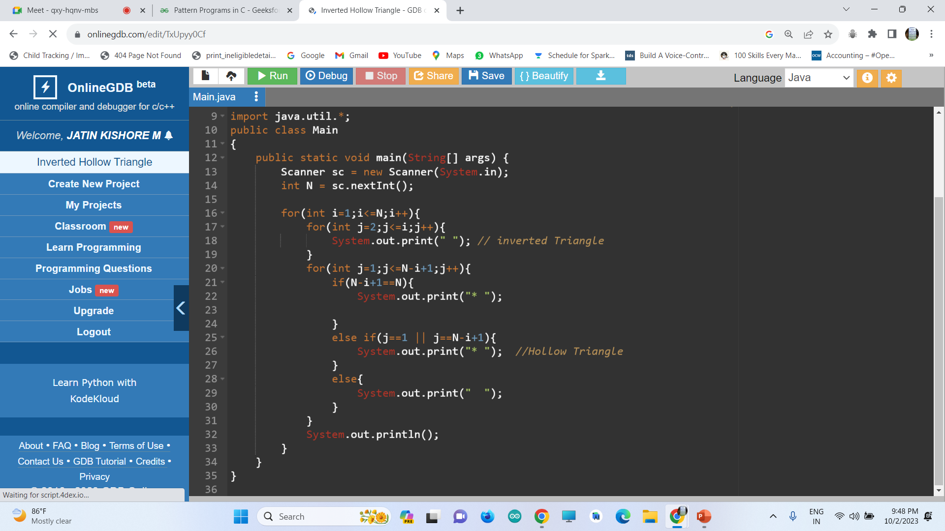
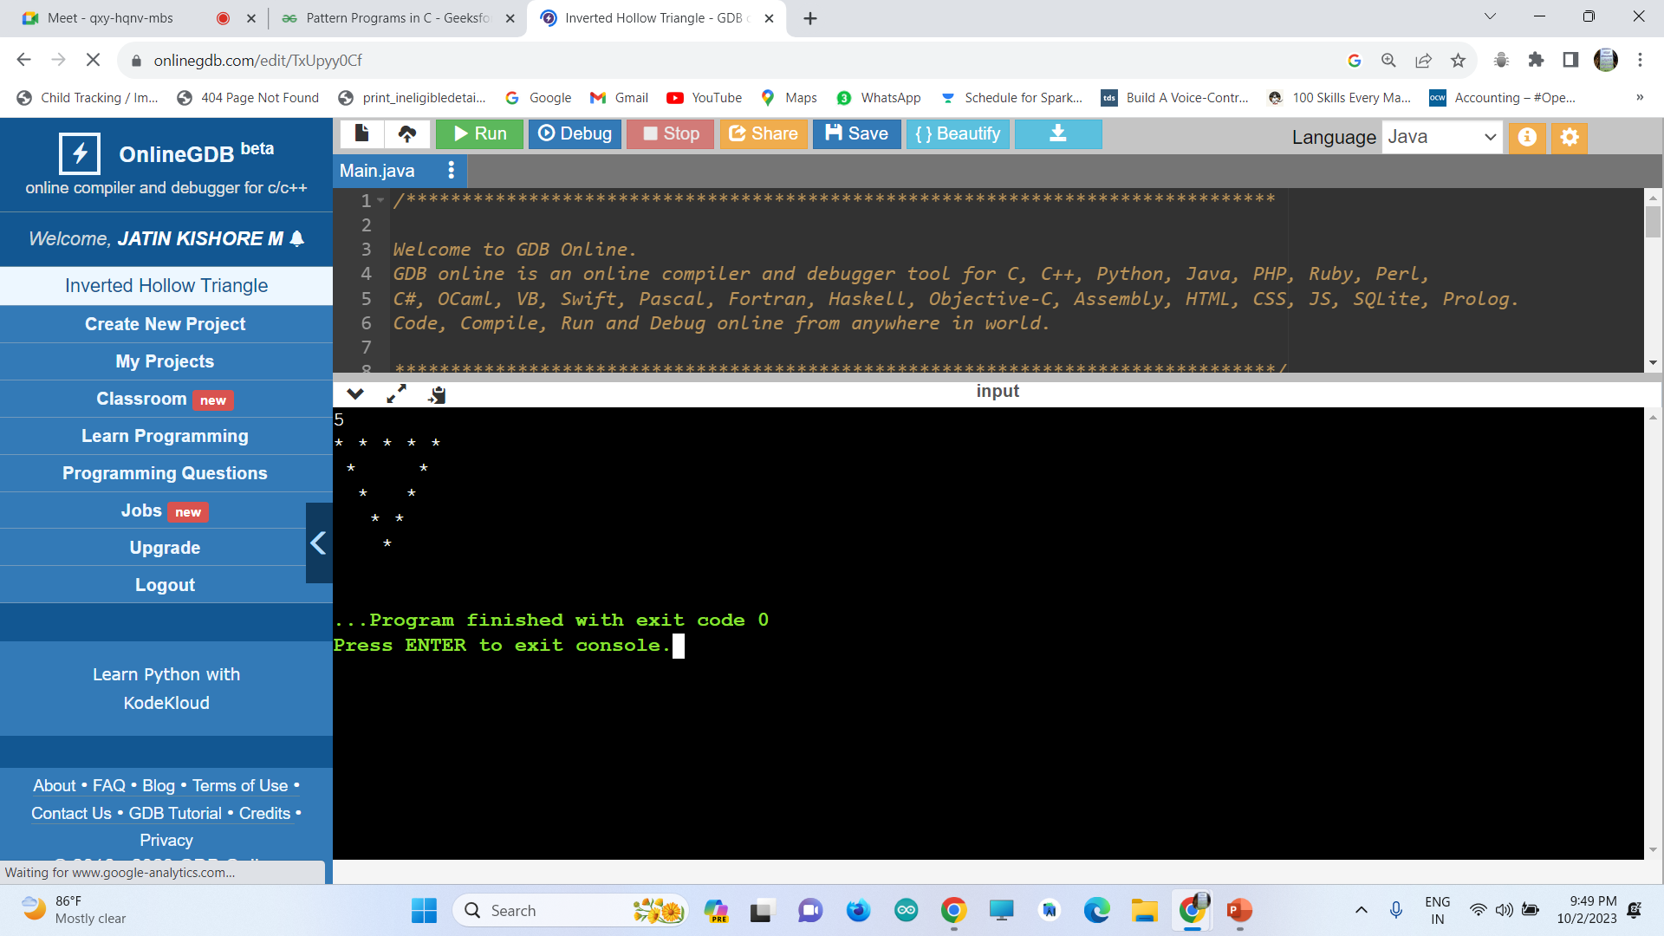

Slide 30
HOLLOW DIAMOND
Combination of
Hollow Triangle + Hollow Inverted Triangle
Note:
Remove the Last line of both triangles.
Also Try to remove first line of Hollow Inverted Triangle
Or
Last line of Hollow Triangle to Combine both

Slide 31
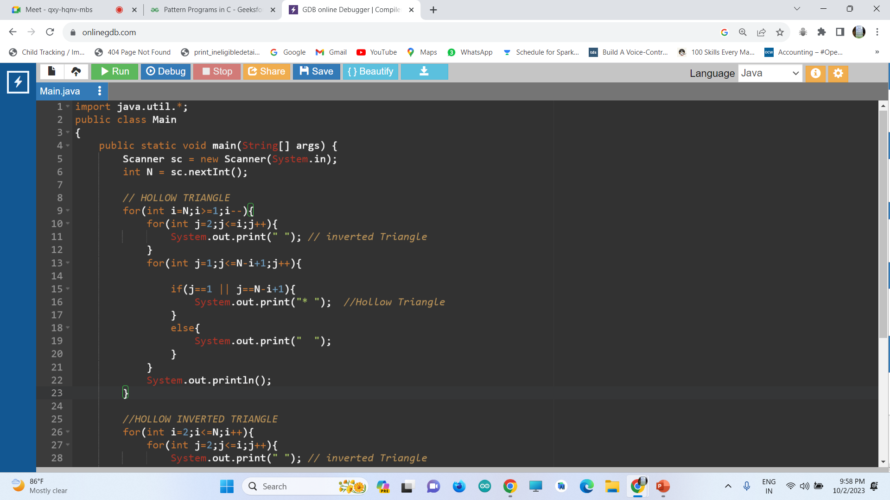
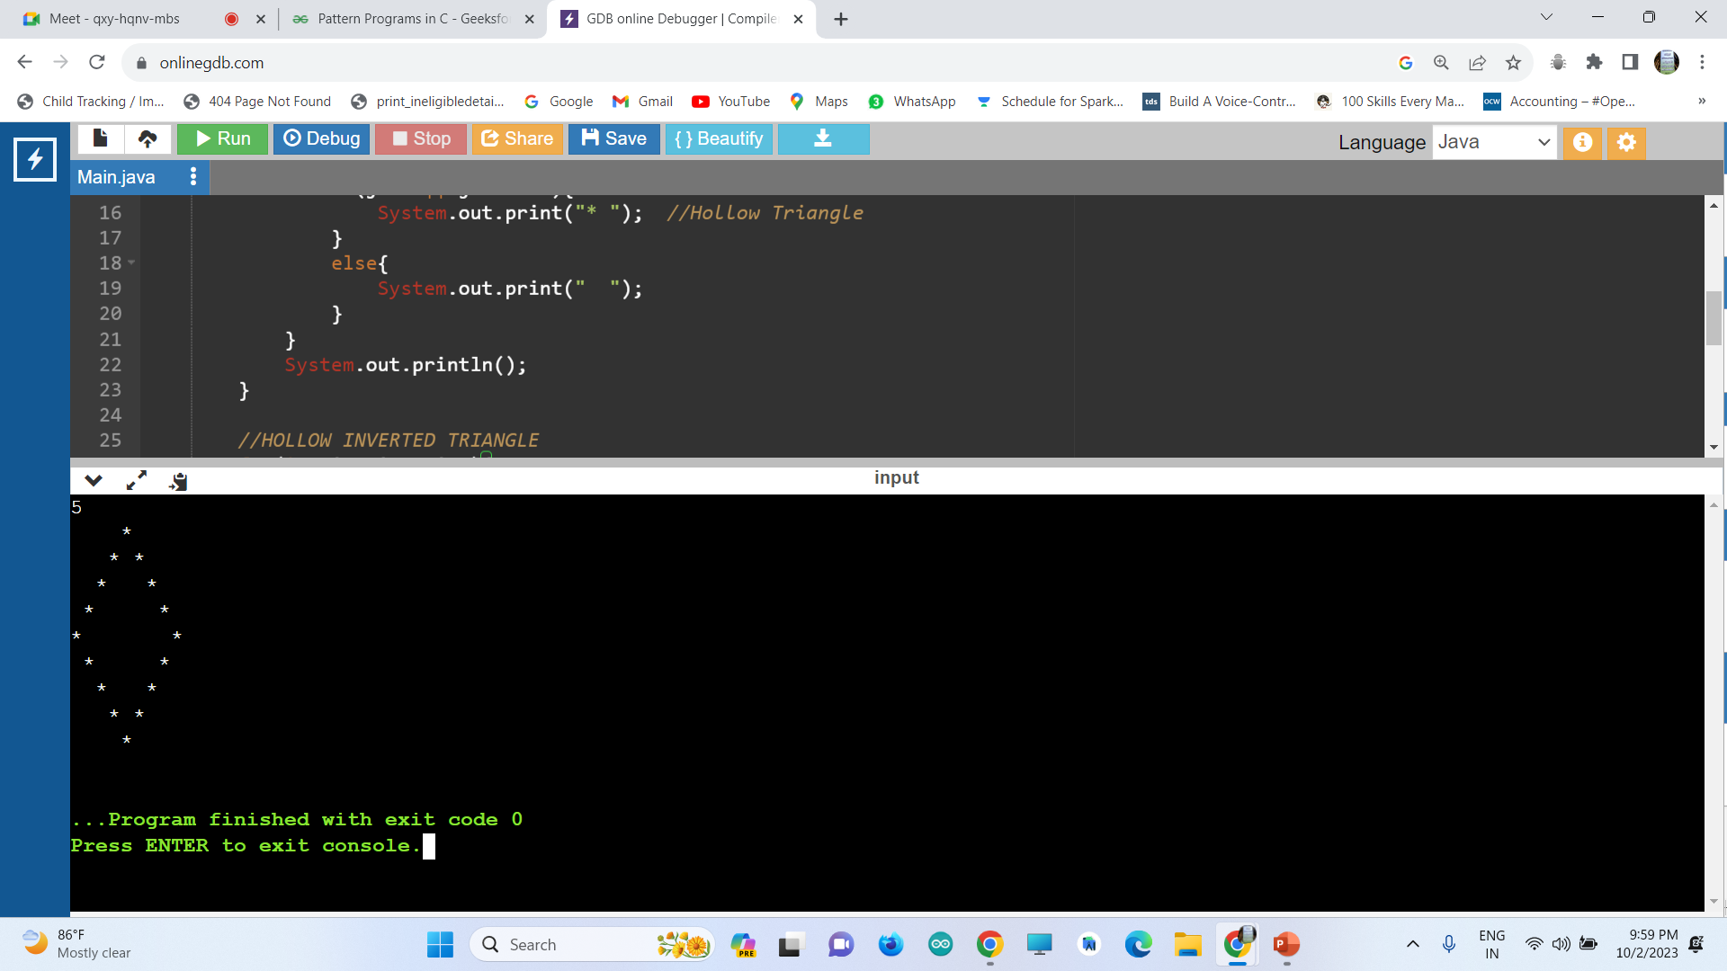
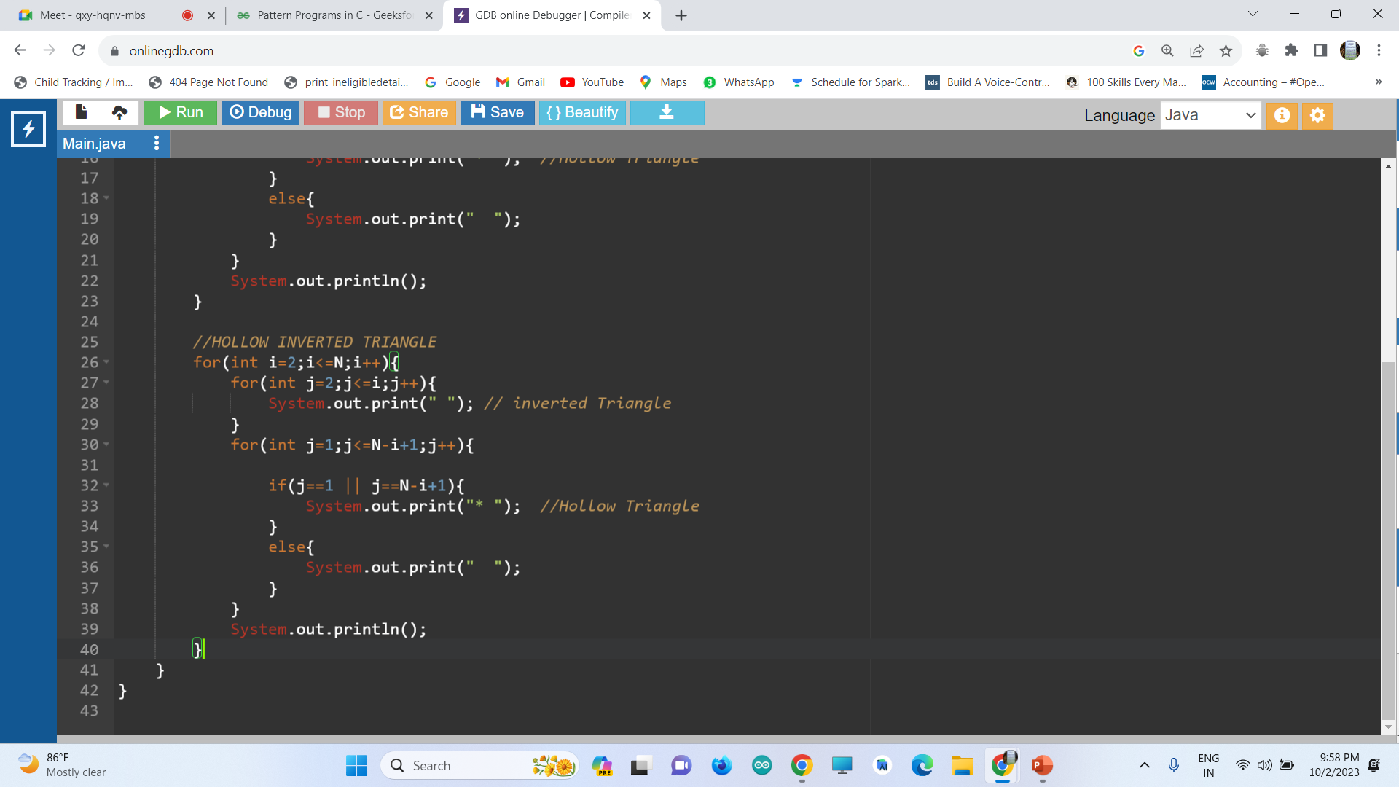

Slide 32
HOLLOW HOURGLASS
Combination of
Hollow Inverted Triangle + Hollow Triangle
Note:
Also Try to remove first line of Hollow Triangle
Or
Last line of Hollow Inverted Triangle to Combine both

Slide 33
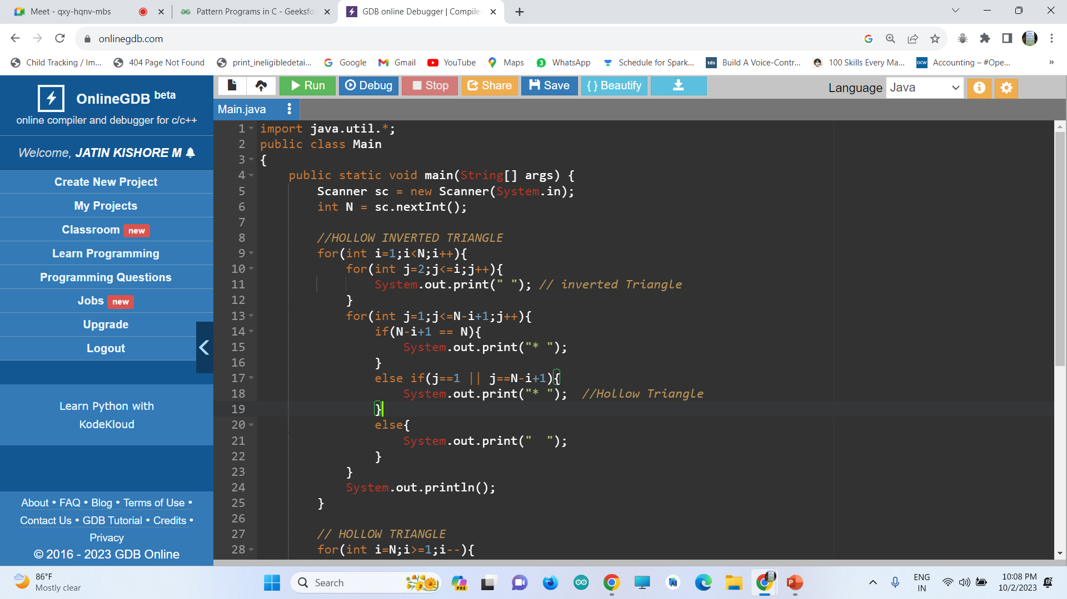
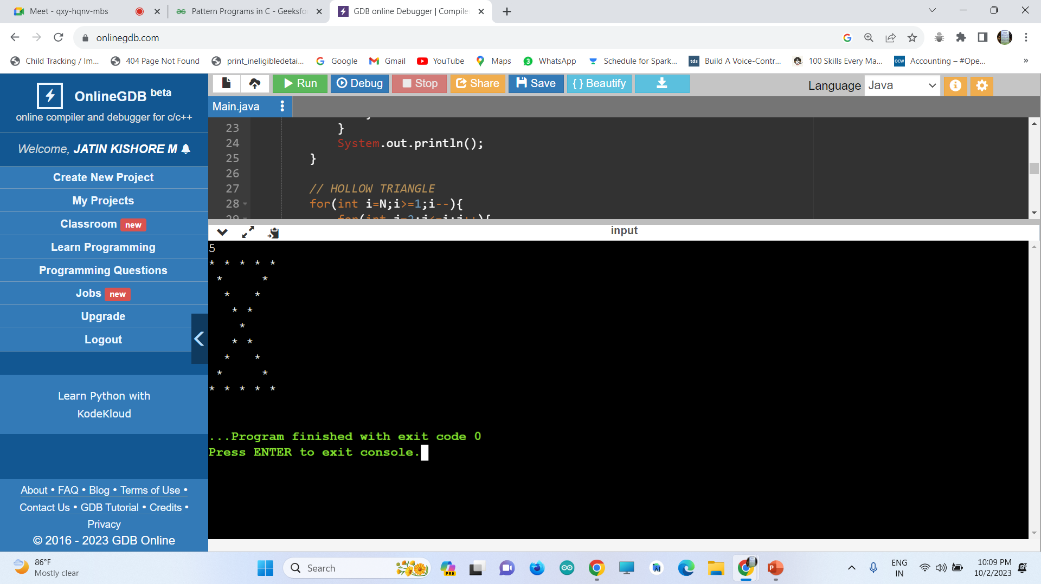


Slide 34
FLOYD’S TRIANGLE
1
2 3
4 5 6
7 8 9 10

Slide 35
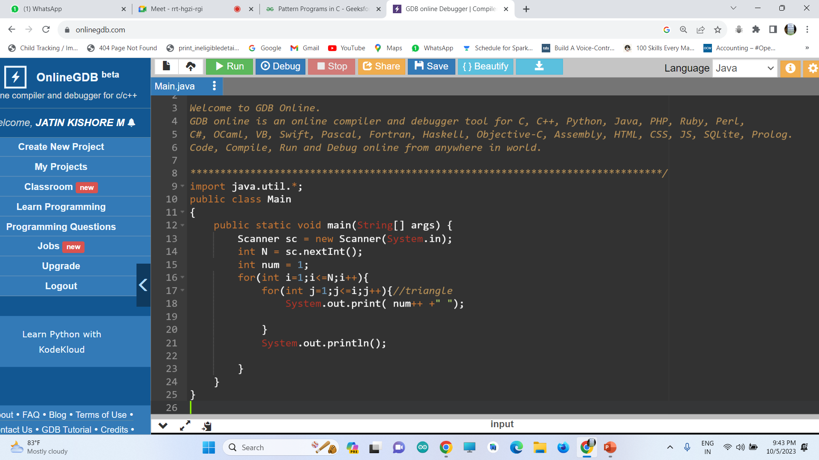
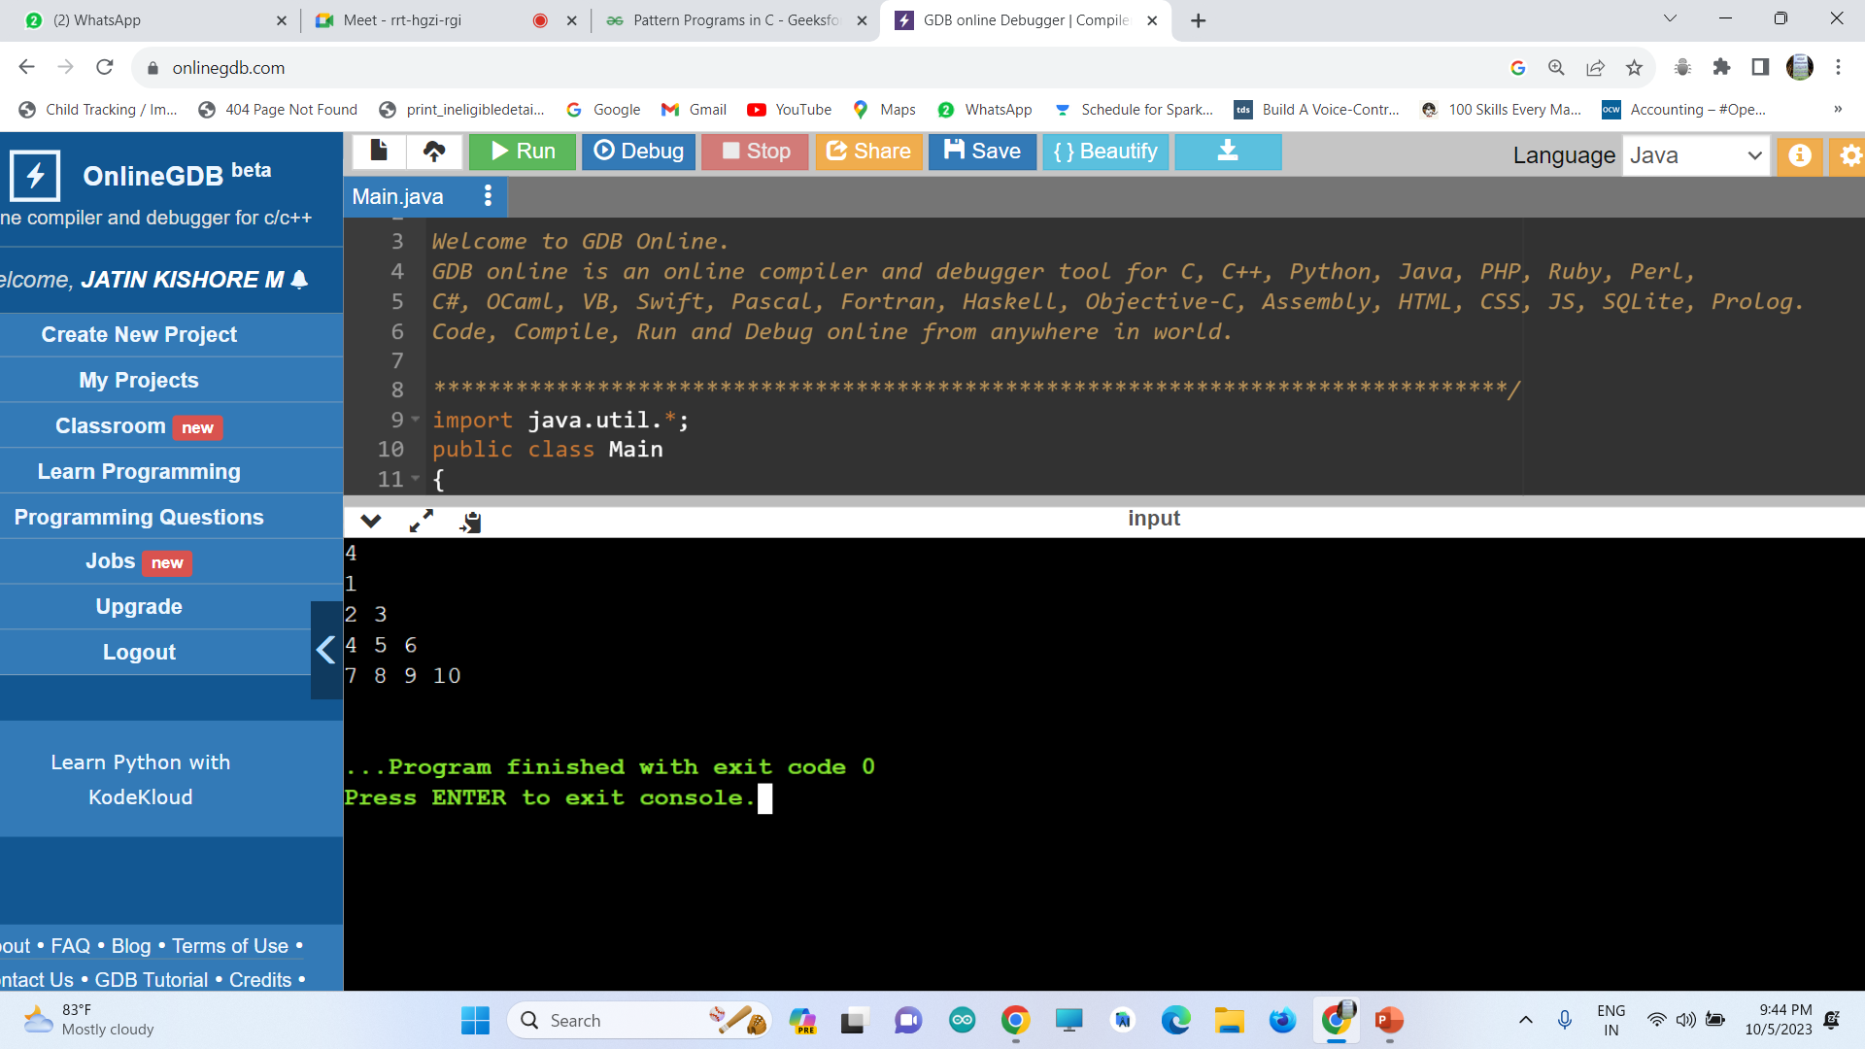

Slide 36

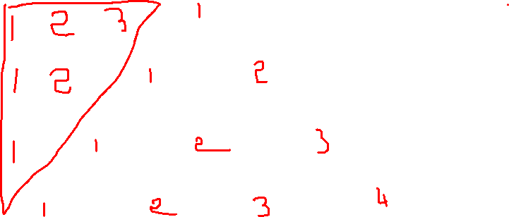

Slide 37
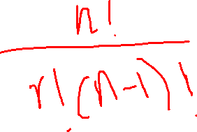
PASCAL ‘S TRIANGLE
Pascal's Triangle is the triangular arrangement of numbers that gives the coefficients in the expansion of any binomial expression.
1
1 2 1
1 3 3 1
1 4 6 4 1
Binomial Coefficient Formula:

Slide 38
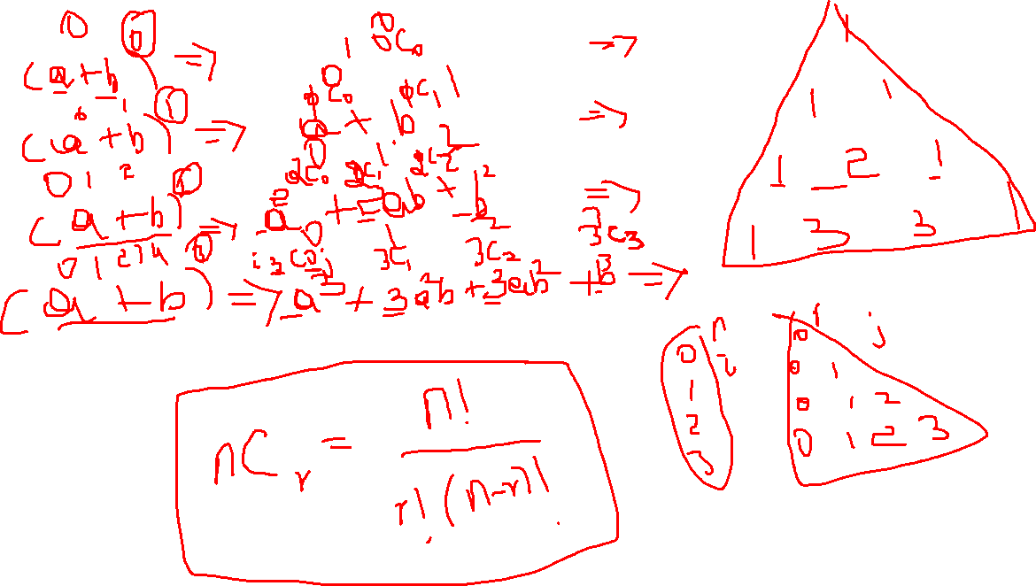
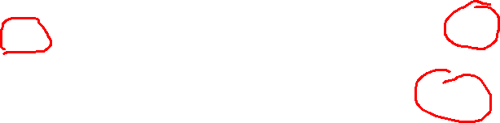

Slide 39
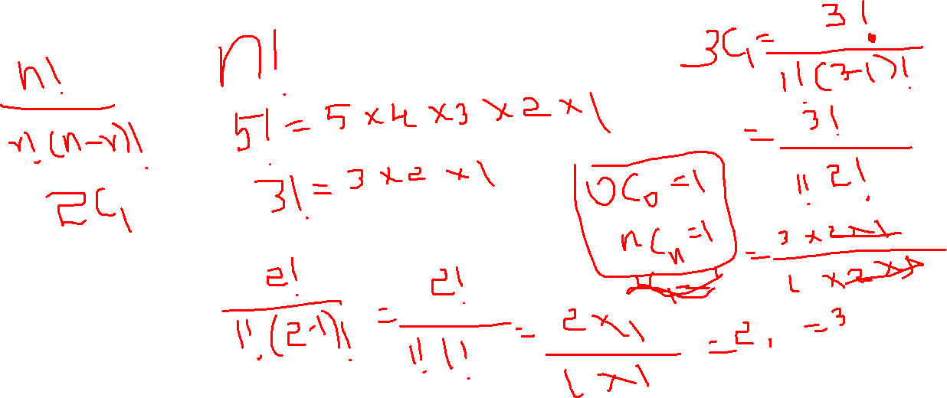

Slide 40
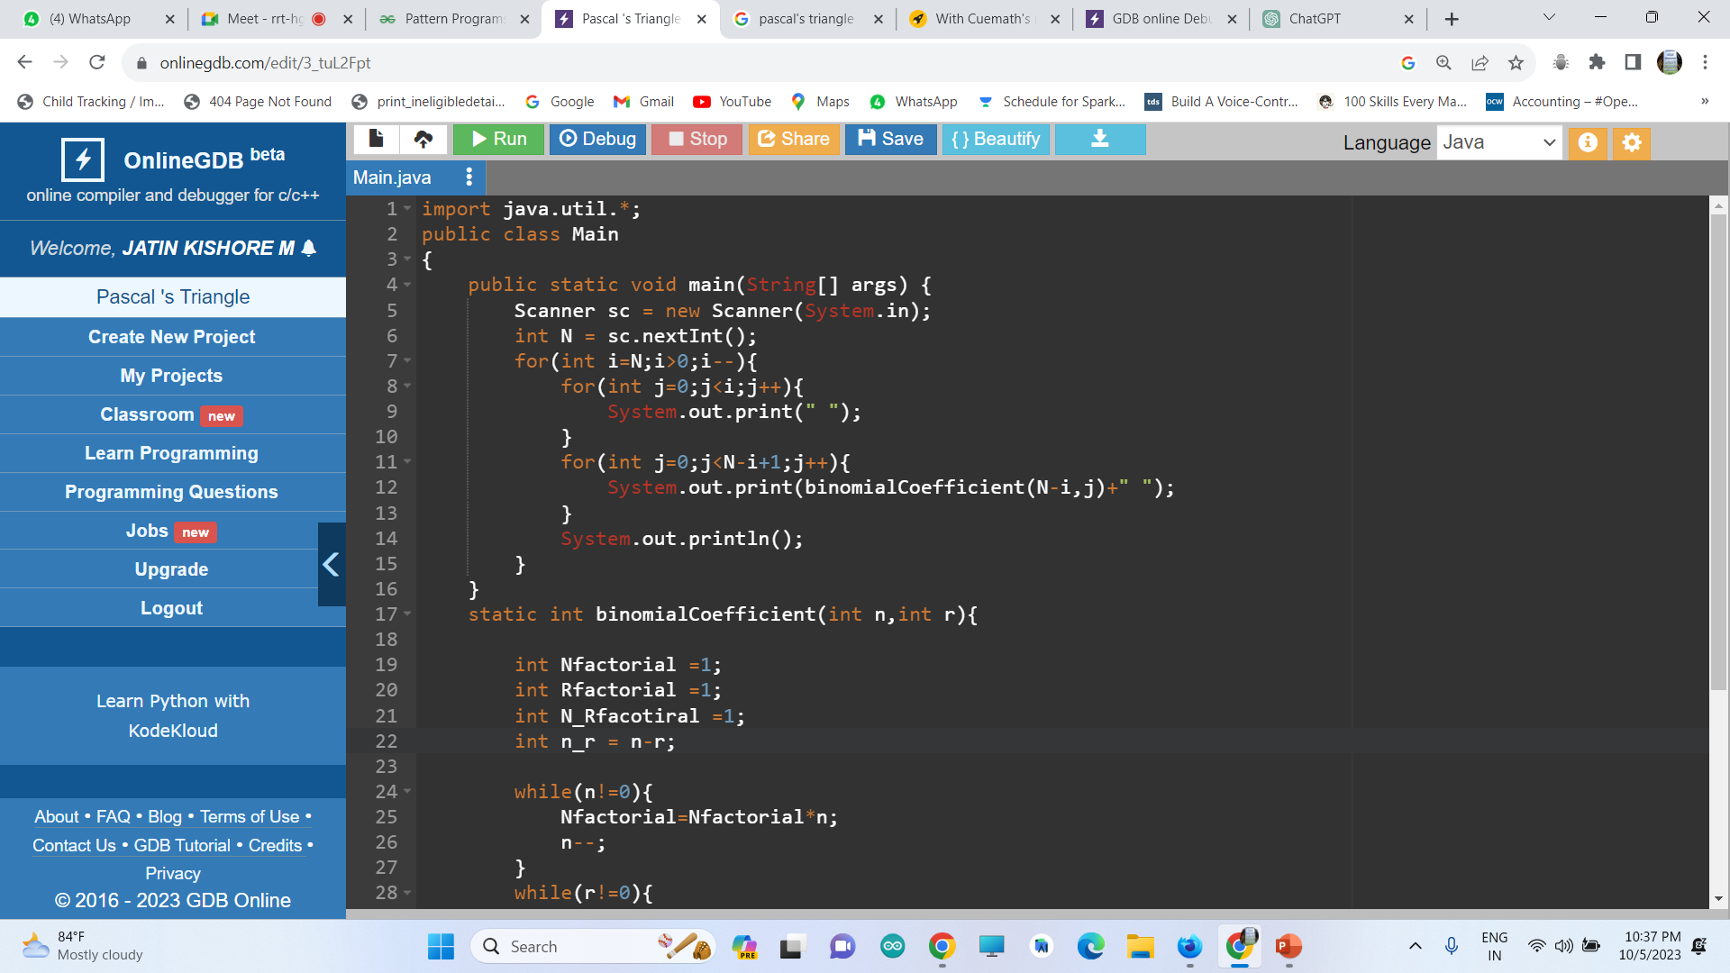
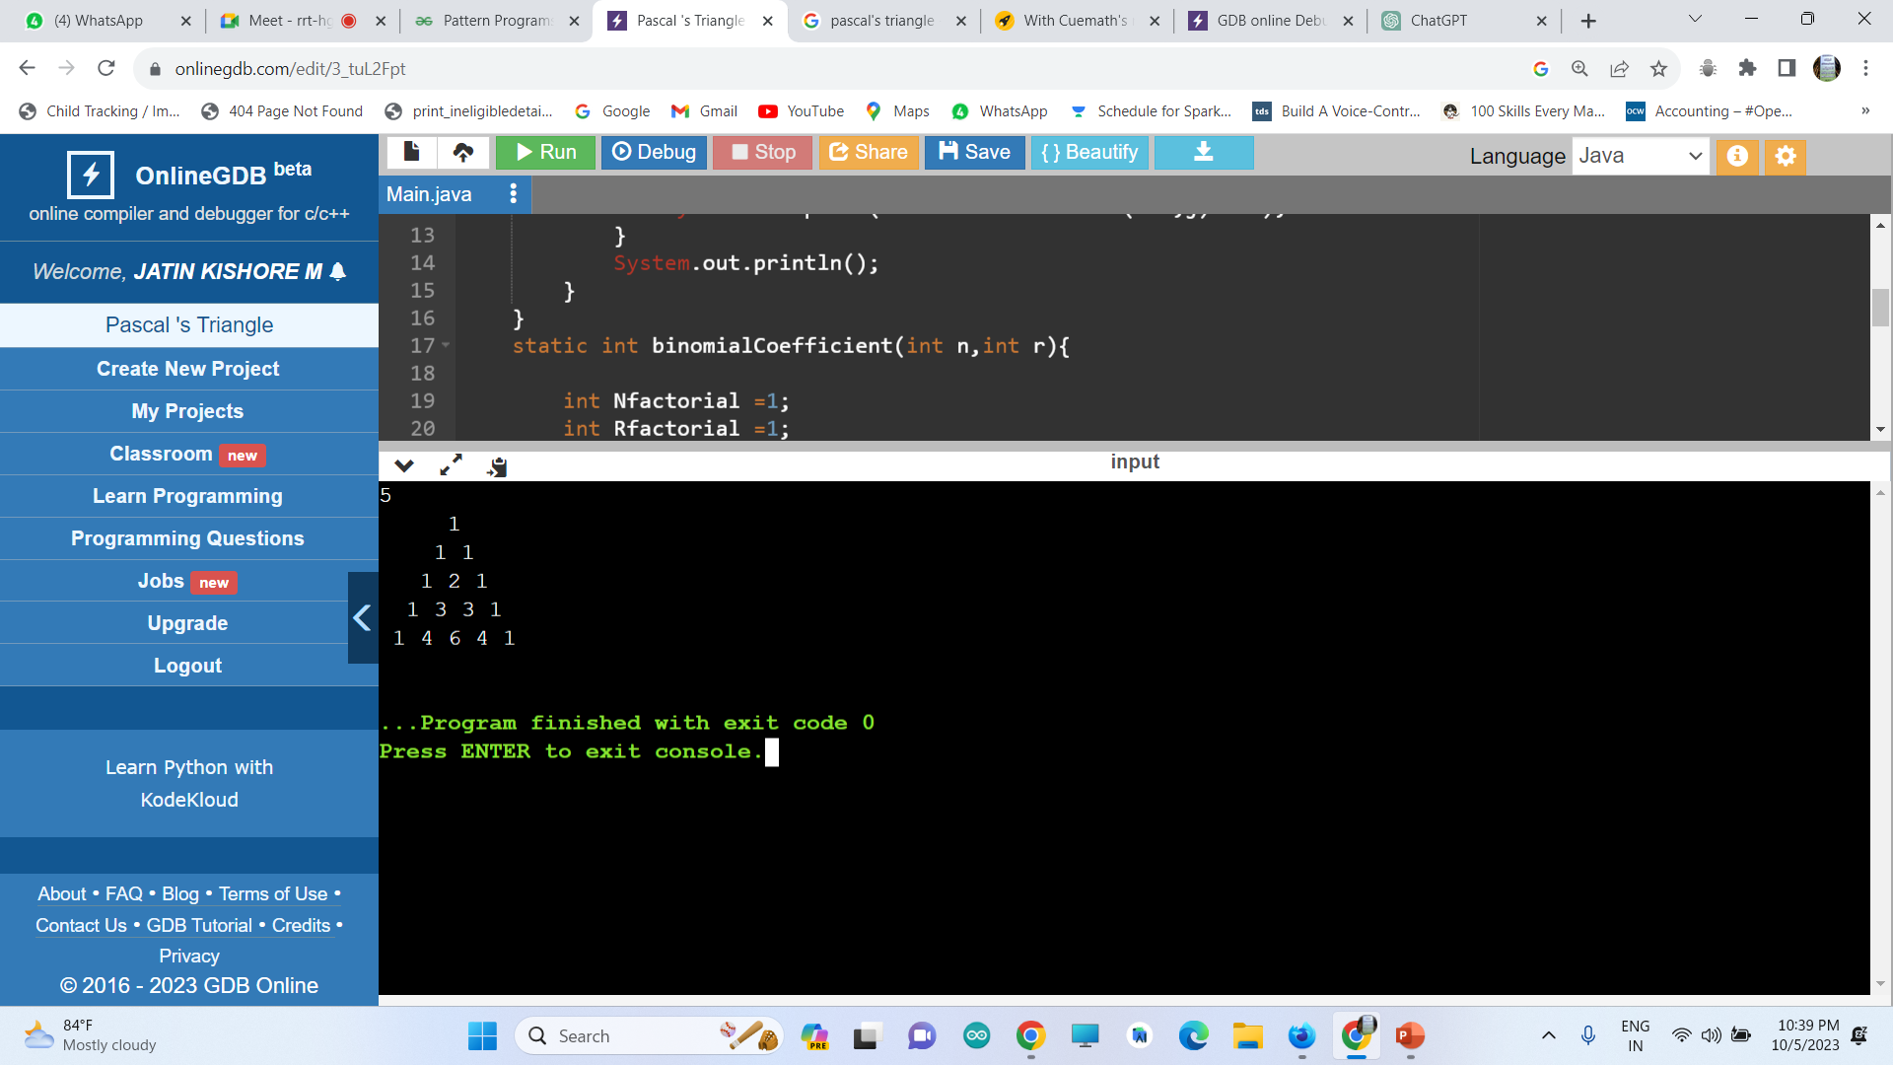
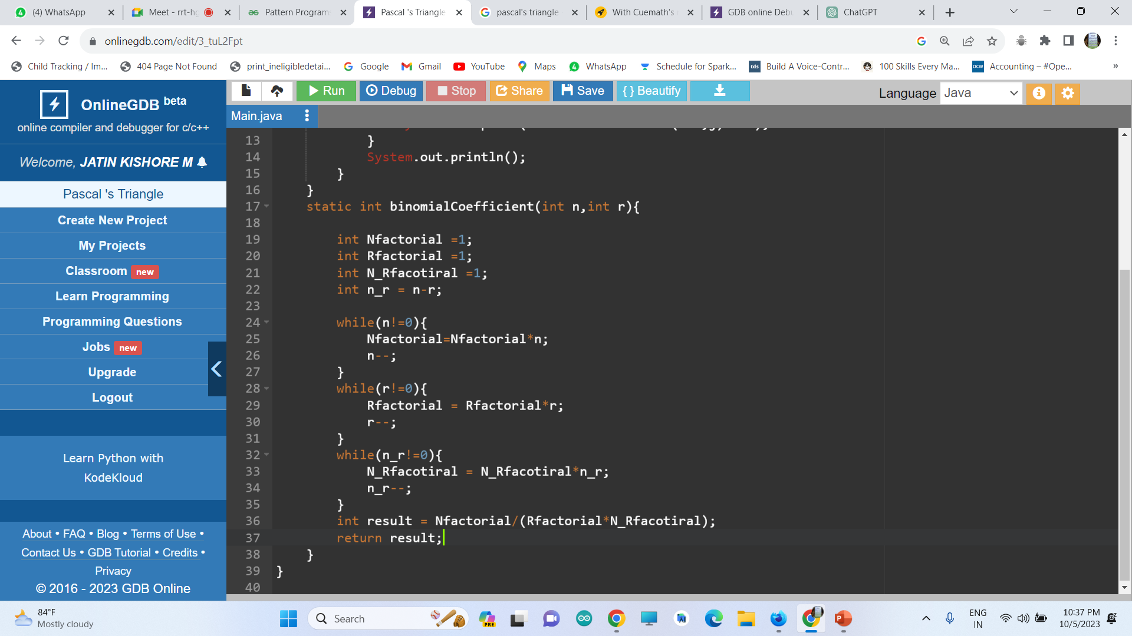

Slide 41
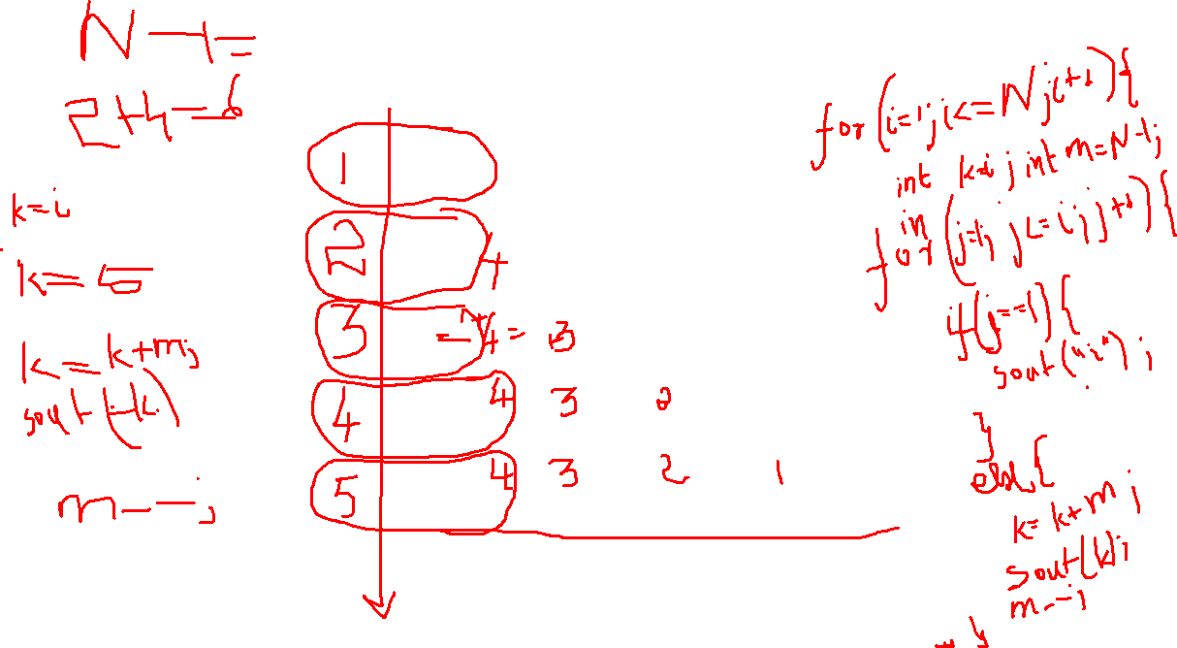
Top to Bottom Numerical Triangle
1
2 6
3 7 10
4 8 11 13
5 9 12 14 15

Slide 42
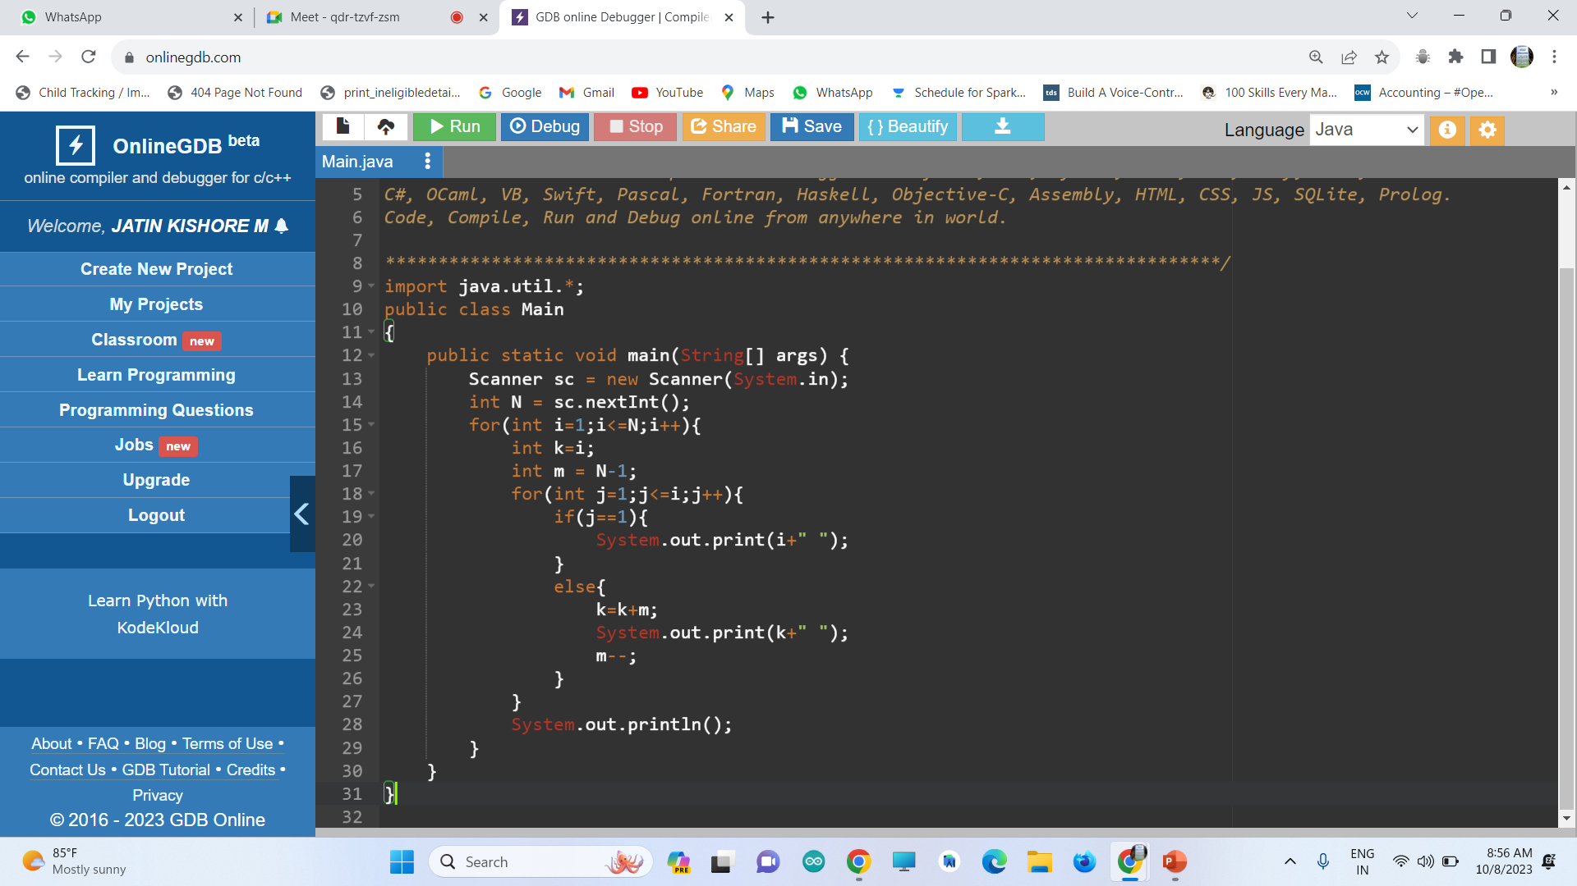


Slide 43


HOME ASSIGNMENT: 1
Corner to Corner Numerical Triangle
1
6 2
10 7 3
13 11 8 4
15 14 12 9 5

Slide 44



Slide 45


WALLS ARE WEAK
0
0
0
0
0
0
1
1
1
0
0
1
2
1
0
0
1
1
1
0
0
0
0
0
0

Slide 46



Slide 47

HOME ASSIGNMENT: 2
WALLS ARE STRONG
4
4
4
4
4
4
3
3
3
4
4
3
2
3
4
4
3
3
3
4
4
4
4
4
4

Slide 48



Star to numerical or character conversion
Numerical
Star
Character

Slide 49
RECURSION
A function calling itself is called Recursion

Slide 50




FLOW OF STACK
Mom
Boy1
Boy2
Boy3

Slide 51





Slide 52
Note:
whatever done before the function call will be performed during bottom to top stack flow and anything done after function call will be performed during top to bottom stack flow
Use Return to break the recursion program and set a breaking condition to break

Slide 53


DON’T USE POST INCREAMENT/DECREMENT IN RECRUSION
i++
SOMETIMES PRE INCREAMENT/DECREMENT IN RECRUSION ALSO LEAD TO WRONG RESULTS
++i
BETTER USE +1
i+1

Slide 54
COUNT 1 to 5 numbers
1
2
3
4
5

Slide 55



count5()
5
Print() -> printed when flow is in bottom to top of the stack
count5()
func() -> function call
4
Print() -> printed when flow is in top to bottom of the stack
count5()
3
count5()
2
count5()
Note: whatever done before the function call will be performed during bottom to top stack flow and anything done after function call will be performed during top to bottom stack flow
1

Slide 56



Slide 57
COUNT 5 to 1 numbers
5
4
3
2
1

Slide 58







How i+1 gives a expected result
How ++i gives a wrong result
The value of i is not assigned with the incremented value.. Just the incremented is value is passed to next function call
The value of i is assigned with the incremented value. Then is passed to the next function call

Slide 59
Product of N numbers
5 x 4 x 3 x 2 x 1 = 120

Slide 60




Slide 61

5
4
3
2
1

Slide 62







Hint: Since the return type is an integer you need to return a integer. If you return 0 at breaking statement then complete product will become 0 . Since the productN(1) will be 0 during top to bottom stack flow. So return 1 at breaking statement in productN(1).

Slide 63
DOUBTS AND DISCUSSION

Slide 64



Slide 65



Slide 66
FIND THE NUMBER IN THE FIBONNANCI SERIES
Question : find the 6 the Fibonacci number
1 2 3 5 8 13

Slide 67

1 1 2 3 5 8 13

Slide 68









Fibo(0)
Fibo(1)
Fibo(2)
Fibo(3)
Fibo(4)
Fibo(5)
main

Slide 69
Fibo(0)
Fibo(1)
Fibo(2)
Fibo(3)
Fibo(4)
Fibo(5)
main

Slide 70

main
Fibo(5)
Fibo(4)
Fibo(3)
Fibo(3)
Fibo(2)
Fibo(1)
Fibo(2)
Fibo(2)
Fibo(1)
Fibo(0)
Fibo(1)
Fibo(0)
Fibo(1)
Fibo(0)
Fibo(1)

Slide 71
Home Assignment : 3
Sum of N numbers
5 + 4 + 3 + 2 + 1 = 15

Slide 72
SUM OF DIGITS
12345 - > 1+2+3+4+5 = 15

Slide 73


1 2 3 4 5

Slide 74

Func(0)
Func(1)
Func(12)
Func(123)
Func(1234)
Func(12345)
main

Slide 75



Slide 76
Home Assignment : 4
PRODUCT OF DIGITS
12345 --> 1x2x3x4x5 = 120

Slide 77
REVERSE A NUMBER
12345
54321
50000 + 4000+300+20+1

Slide 78


12345

Slide 79



Slide 81
Home Assignment : 5
CHECK PALINDROME OF A NUMBER
1221 == 1221 → True
1231 != 1321 → False

Slide 82
Arrays
in Recursion

Slide 83
Check whether the array is sorted or not
1 2 3 4 5 → True
5 3 4 8 7 → False

Slide 84

1 2 3 4 5

Slide 85


Slide 86



Slide 87
Find the Index of the Target element
Index-> 0 1 2 3 4
1 2 3 4 100

Slide 88



Slide 89
Find all the possible Indices of the Target element
Index-> 0 1 2 3 4
100 2 3 100 100

Slide 90




Slide 91
Pattern printing
In recursion

Slide 92



Make a Inverse Triangle

Slide 93



Slide 94
Make a Triangle
NOTE: To inverse any pattern just put the recursion function above the print statement.

Slide 95



Slide 96



Slide 97


Avoiding the extra space

Slide 98
Sorting Algorithms in Recursion

Slide 99

Bubble Sort

Slide 100


Slide 101



Slide 102



Selection Sort

Slide 103


Slide 104



Slide 105



Merge Sort
Divide and Conquer
5
4
3
1
2
4
5
1
2
3

Slide 106






5
4
3
1
2
N:
Mid:
N:
Mid:
5
4
3
1
2
N:
Mid:
N:
Mid:
5
4
3
N:
Mid:
N:
Mid:
1
2
N:
Mid:
1
2
N:
Mid:
N:
Mid:

Slide 107




Slide 108
Quick Sort
5
4
3
2
1
Principle:
Choosing a pivot a element
All elements less than pivot will be in the left side
All elements greater than pivot will be in the right side
Partitioning
Low and high → main elements this determines which part of the array
S and e → to move over the indices

Slide 109
Concepts
Bubble and Selection sort → In the first pass the largest element will be in the last position.
Merge Sort → sort the array in half’s.
Quick Sort → In the first pass the pivot element come to its position

Slide 110

S=
e=
mid=
P =arr[mid]=
5
4
3
2
1

Slide 111






5
4
2
1
S=
e=
mid=
P =arr[mid]=
1
2
3
4
5
S=
e=
mid=
P =arr[mid]=
S=
e=
mid=
P =arr[mid]=

Slide 112



5
4
3
2
1
5
4
3
2
1

Slide 113


n
n/2
n/2
n/4
n/4
n/4
n/4
n/8
n/8
n/8
n/8
n/8
n/8
n/8
n/8

Slide 114


Slide 115




